Slide 1
JOURNEY SCRAPBOOK
Shyam TibrewaL (655386)

Slide 2



CUSTOM Training
29th Aug - 6th oct

Slide 3
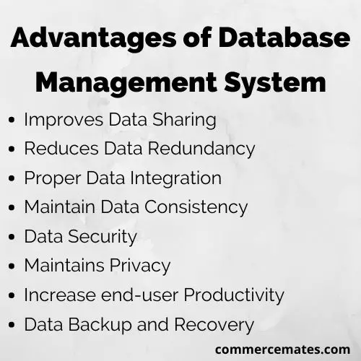
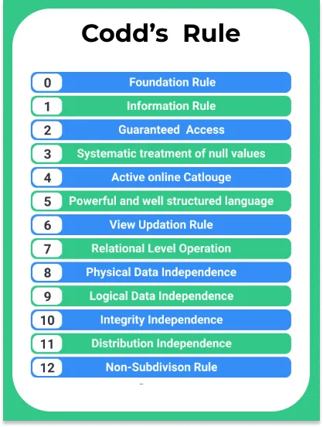
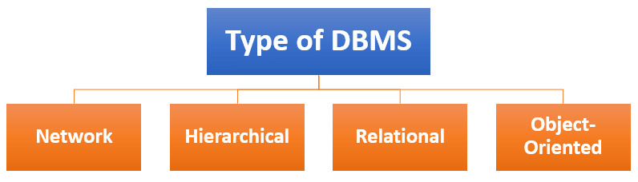
DATA FUNDAMENTALS Day-1
29th Aug
Topics Covered:
What is DBMS?
Purpose of DBMS
Key Components of DBMS
Data
Database
Hardware
Software
Advantages of using DBMS
Difference between Database and DBMS
Difference between DBMS and RDBMS
Codd’s 12 Rules
Types of DBMS
Relational DBMS
Hierarchical DBMS
Network DBMS
Object-Oriented DBMS

Slide 4
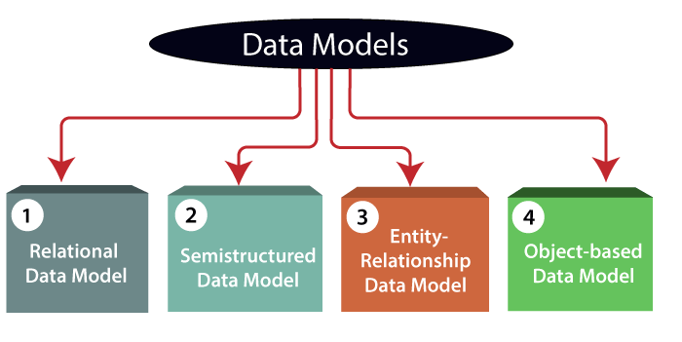
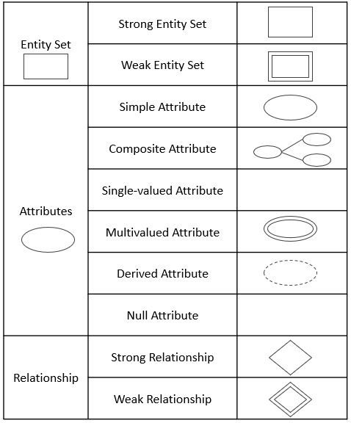
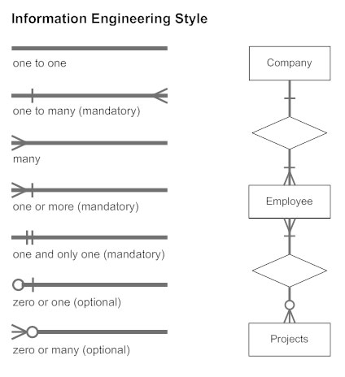
DATA FUNDAMENTALS DAY-1
29th Aug
Topics Covered:
Data Model
Relational Model
ER Model
Object-Based Model
Semi-structured Model
Use of ER Diagrams
Symbols in ER Diagrams
Entity
Weak Entity
Attributes
Key Attribute
Multivalued Attribute
Composite Attribute
Derived Attribute
Relationships
One-to-One
One-to-Many
Many-to-One
Many-to-Many

Slide 5
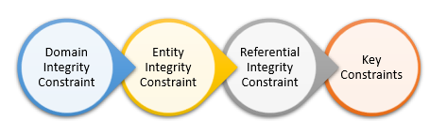
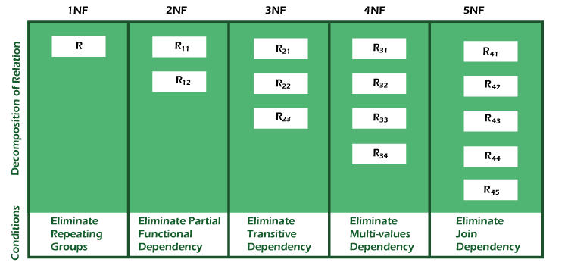
DATA FUNDAMENTALS DAY-1
29th Aug
Topics Covered:
SQL
SQL Commands
DDL
DML
DCL
DQL
TCL
Integrity Constraints
Normalization
1NF
2NF
3NF
BCNF
4NF
5NF

Slide 6
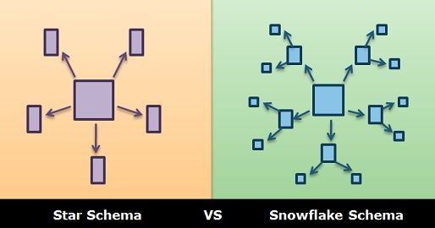
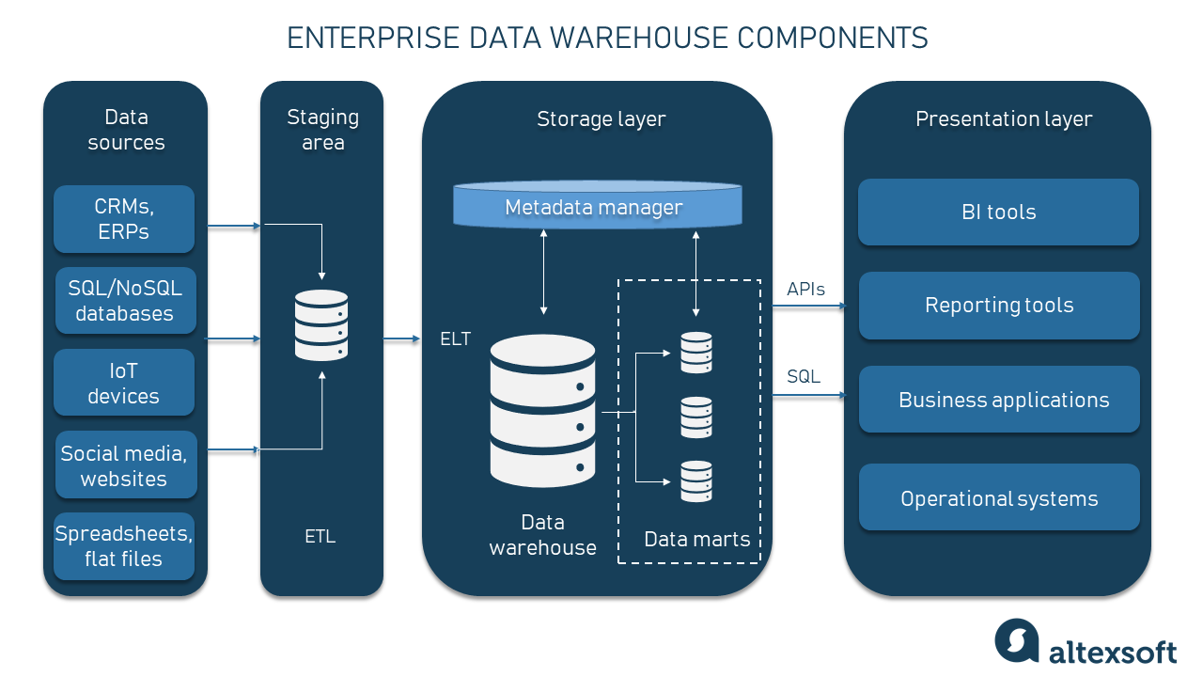
DATA FUNDAMENTALS DAY-2
30th Aug
Topics Covered:
Data Warehouse
Need of Data Warehouse
Schema
Database Schema
Physical
Logical
View
Star Schema
Snowflake Schema
Fact Table
Dimension Table
List of Keys
Rapidly Changing Dimension
Slowly Changing Dimension
Type 1 – Overwrite
Type 2 – Add New Row
Type 3 – Add New Column
EDW and its Components
ELT and ETL
Staging Area

Slide 7
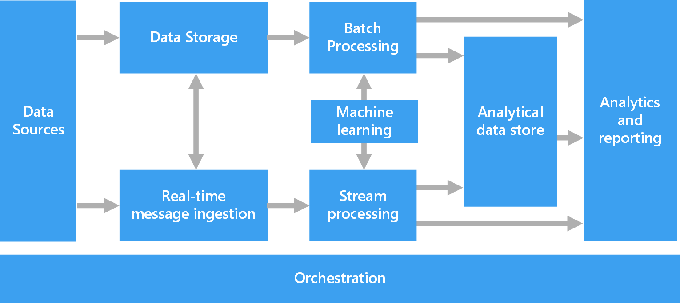
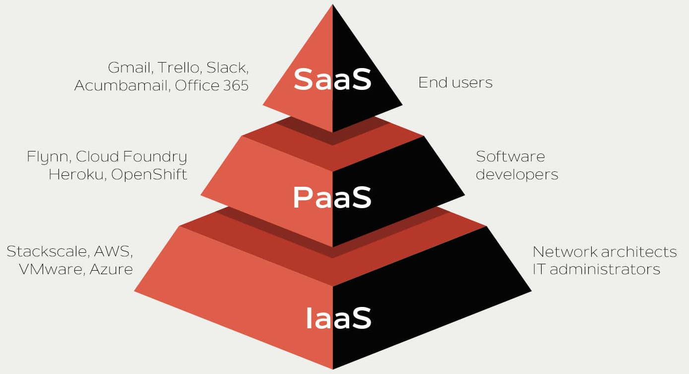
DATA FUNDAMENTALS DAY-2
30th Aug
Topics Covered:
Big Data
Characteristics of Big Data
Volume
Velocity
Value
Veracity
Variety
Variability
Challenges of Big Data
Big Data Architecture
Importance of Big Data
Types of Data
Structured
Unstructured
Semi-structured
Cloud Service Models
IaaS
PaaS
SaaS

Slide 8
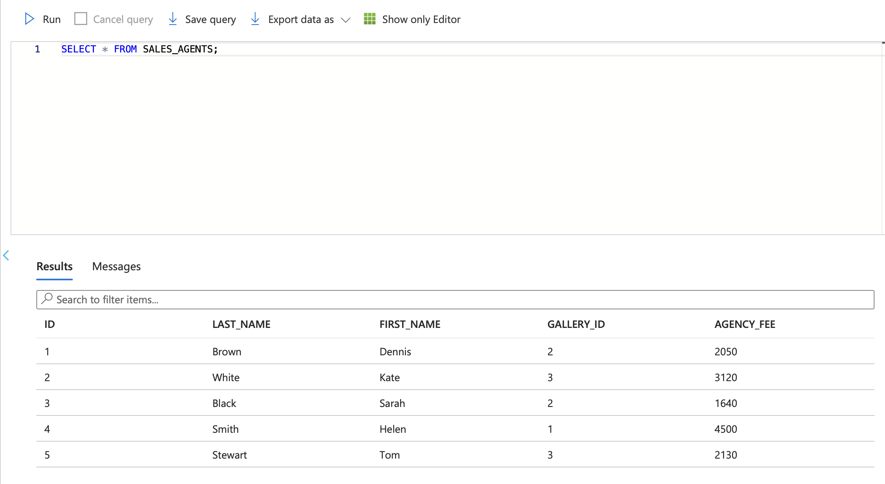
Azure SQL DAY-1
31st Aug
Topics Covered:
Azure SQL
Features of Azure SQL
Hands-On-Lab
Creating SQL Server
Creating SQL Database
Creating Tables
Inserting Data
Updating Data
Usage of DCL - Grant, Revoke, Update commands
Truncating Data
Filtering Data
Sorting Data
Group By Command
Having
Dropping Table

Slide 9
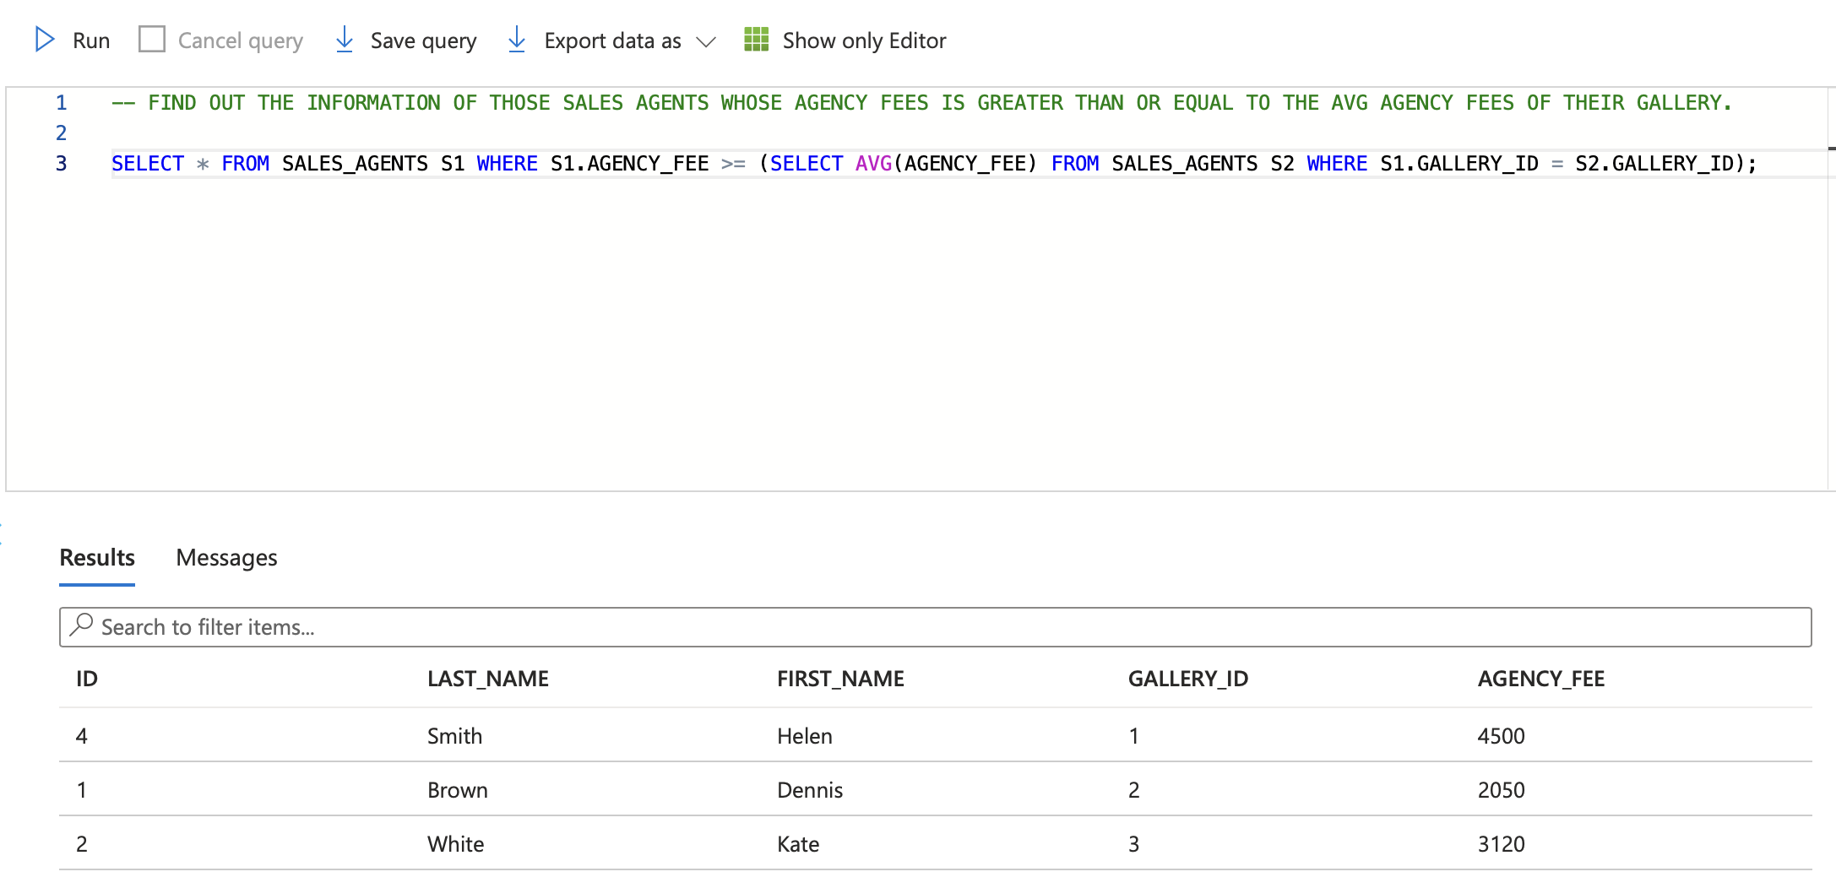
Azure SQL DAY-2
1st Sept
Hands-On-Lab
Joins
Inner
Left
Right
Outer
Union, Union All, Intersect
Subqueries
Single Row
Multiple Row
Multiple Column
Correlated
Nested
Views
Indexes
Clustered
Non-Clustered
ColumnStore
Procedures
Functions

Slide 10
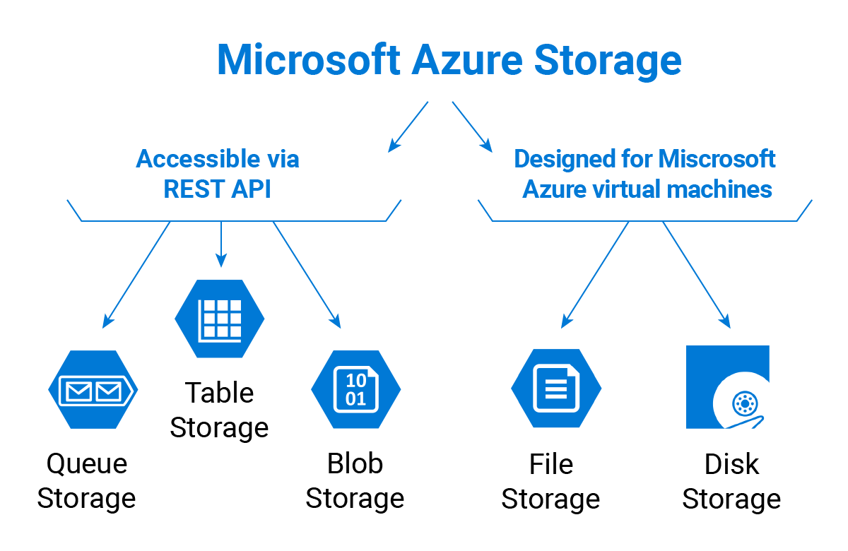
AZURE STORAGE TYPES DAY-1
4th Sept
Topics Covered:
Azure Storage
Blob Storage
File Storage
Queue Storage
Table Storage
Disk Storage
Data Lake Storage
Shared Access Signature
Azure Backup
Azure Storage Redundancy Option
Locally Redundant Storage
Geo-redundant Storage
Zone-redundant Storage
Azure Access Tiers
Hot Tier
Cool Tier
Archive Tier
Hands On Lab:
Creating Blob Storage Account
Creating Container
Uploading Files to Container
Creating a Static Website
Creating Data Lake Gen2 Account

Slide 11
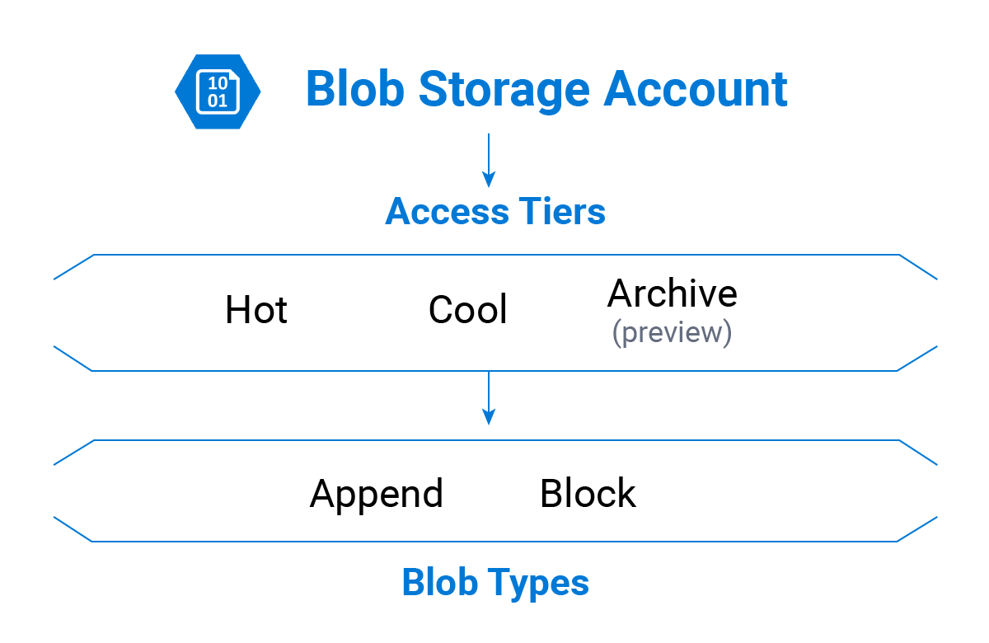
AZURE STORAGE TYPES DAY-2
5th Sept
Topics Covered:
Access and Authentication
Azure Active Directory Authentication
Shared Access Signatures
Role-based Access Control
Access Control Lists
Virtual Network Service Endpoints
Private Endpoints
Hands On Lab:
Azure Active Directory Authentication
Shared Access Signatures
Trying Different Storage Redundancy while Creating a Storage Account
LRS
ZRS
GRS
GZRS
Creating Snapshot of the File in Container
File Shares, Queues and Tables
Changing Different Tiers to Access a File
Hot Tier
Cool Tier
Archive Tier

Slide 12
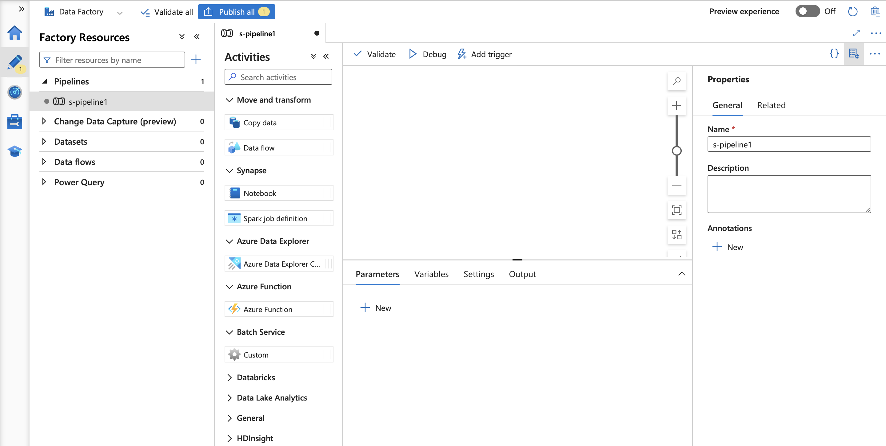
AZURE DATA FACTORY DAY-1
5th Sept
Topics Covered:
Introduction of ADF
Benefits of ADF
Steps Involved in ETL Process
Use Cases for ETL
Need of ADF
ELT vs ETL
Datasets
Integration Runtime
Parameters
System Variables
Data Flows
Linked Services
Triggers
Activities
Debugging and Monitoring
Pipeline
Pipeline Chaining
Hands On Lab:
Creating Data Factory
Creating Pipeline
Introduction to Copy_Data
Introduction to Data_Flow

Slide 13
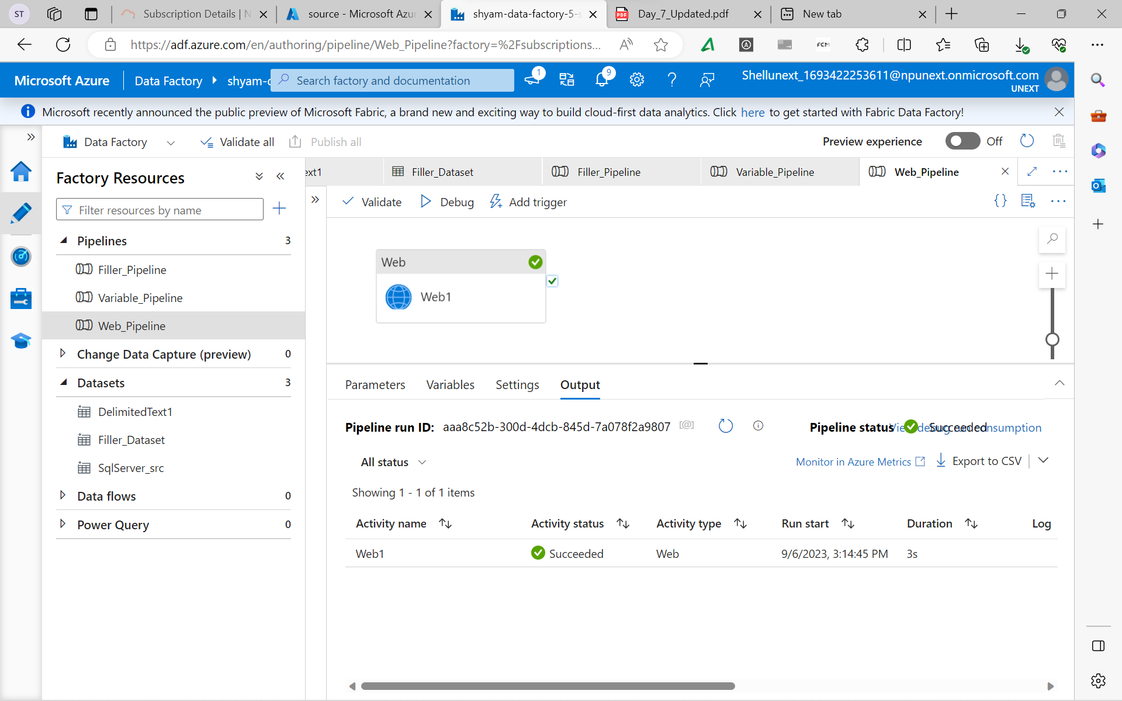
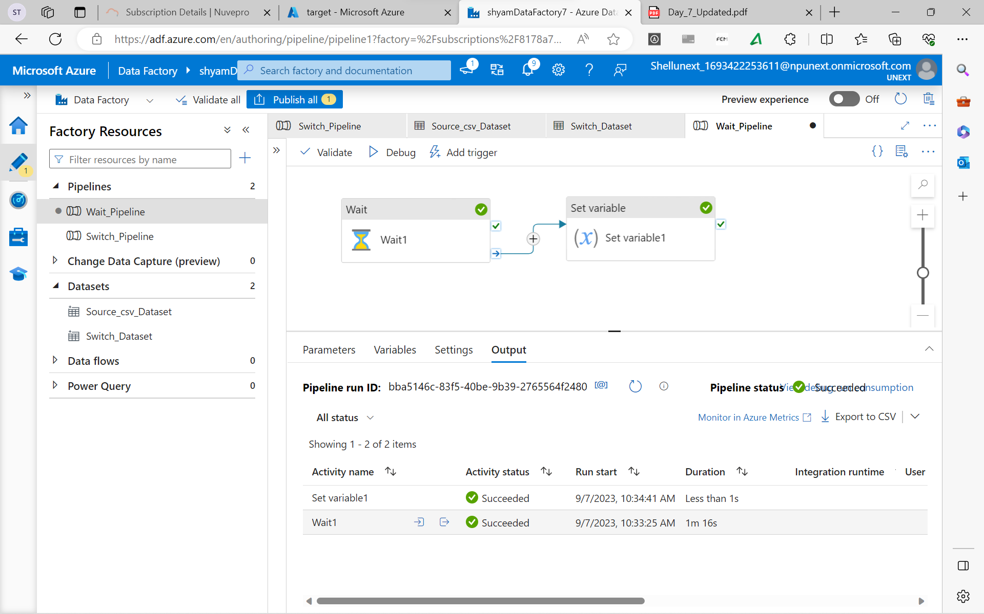
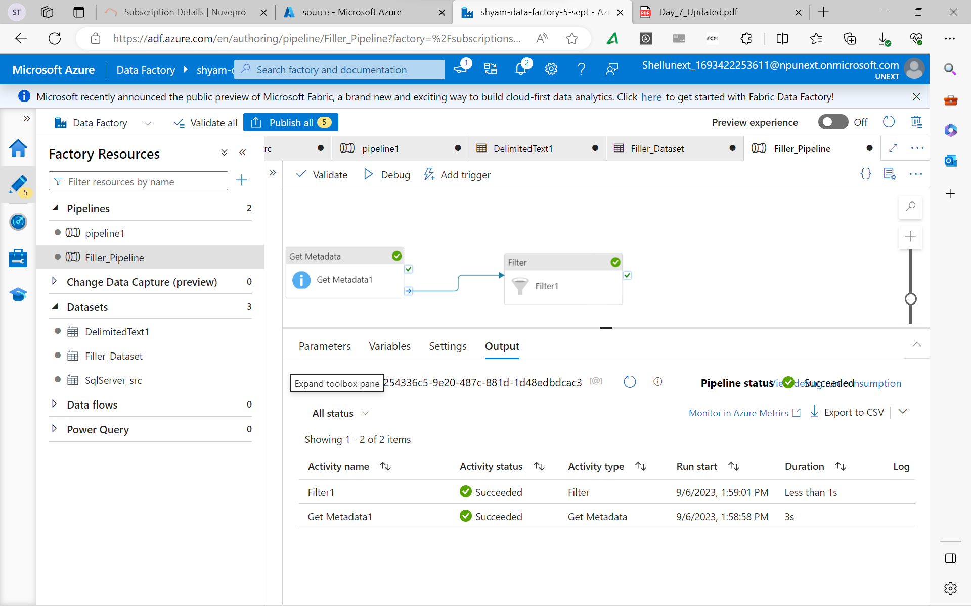
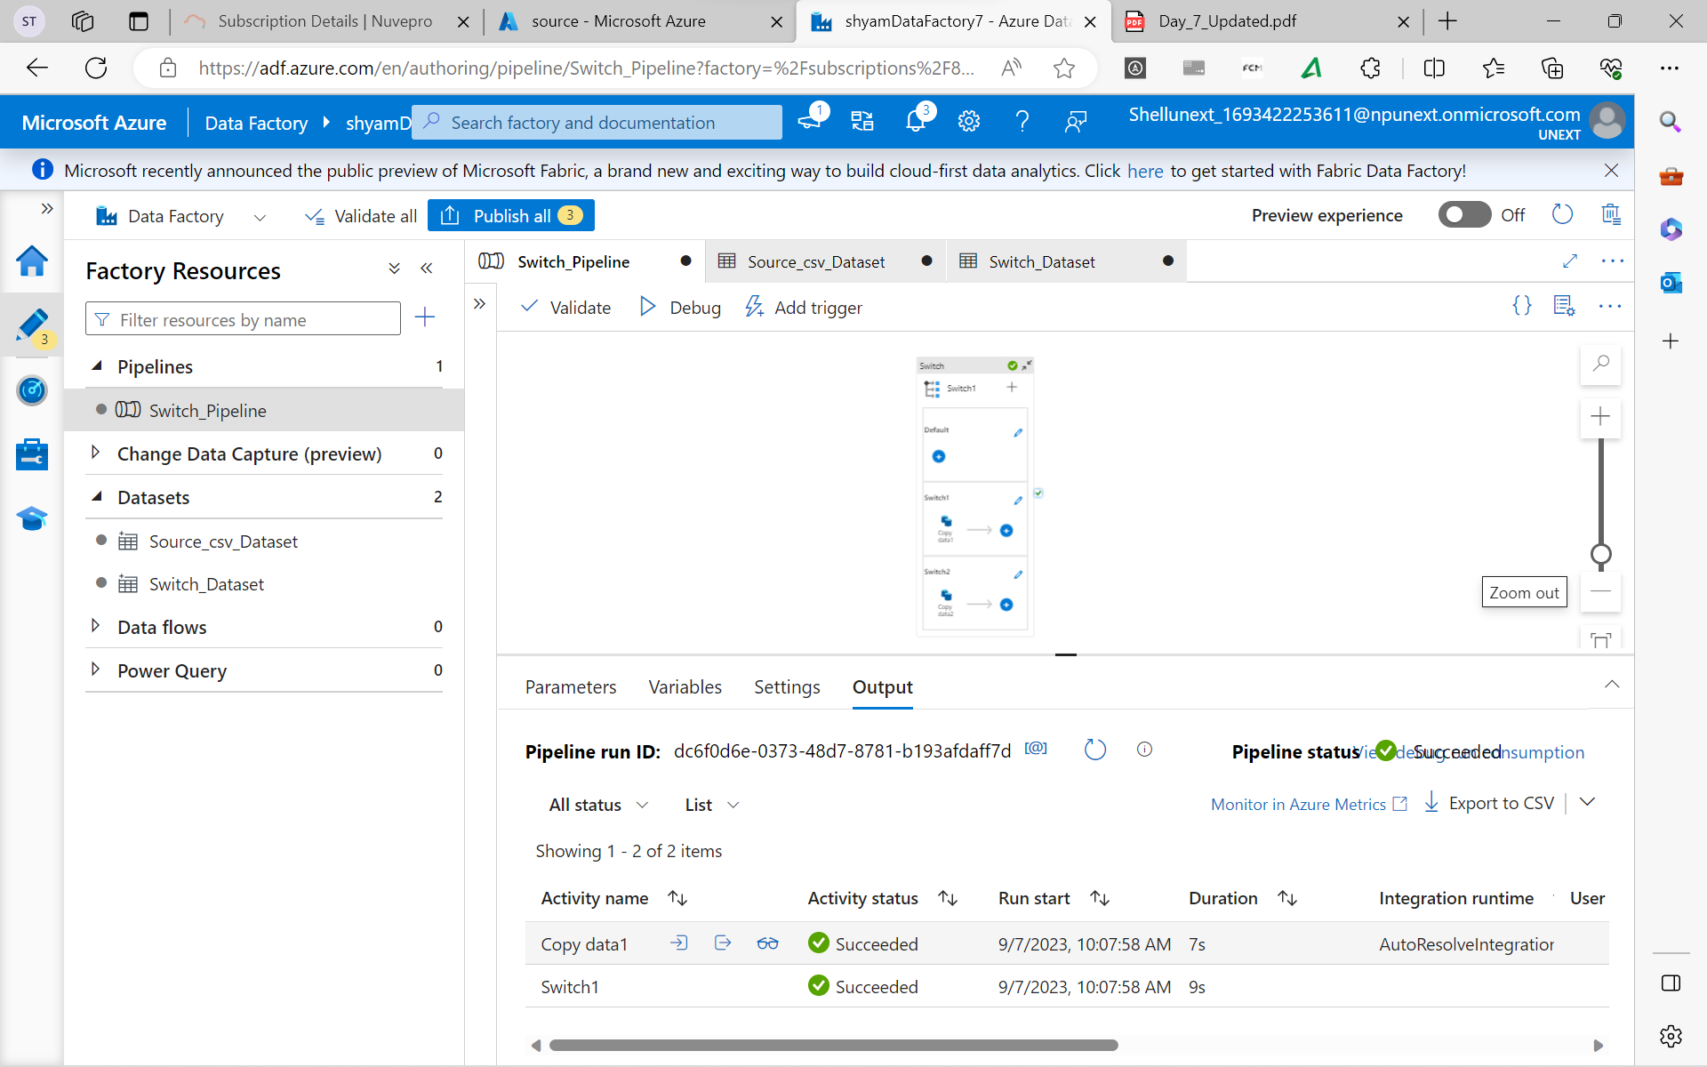
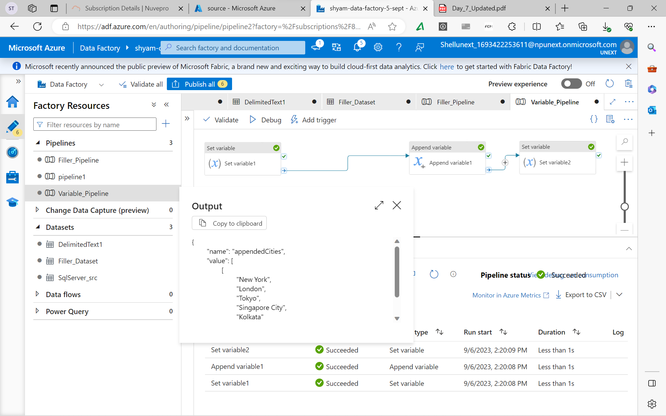
AZURE DATA FACTORY DAY-2
6th Sept
Hands On Lab:
Creating SQL Server
Creating SQL Database
Creating Linked Service
Creating Dataset
Control Flow Activities
If
For Each
Set Variable
Filter
Append
Until
Web
Switch
Wait

Slide 14
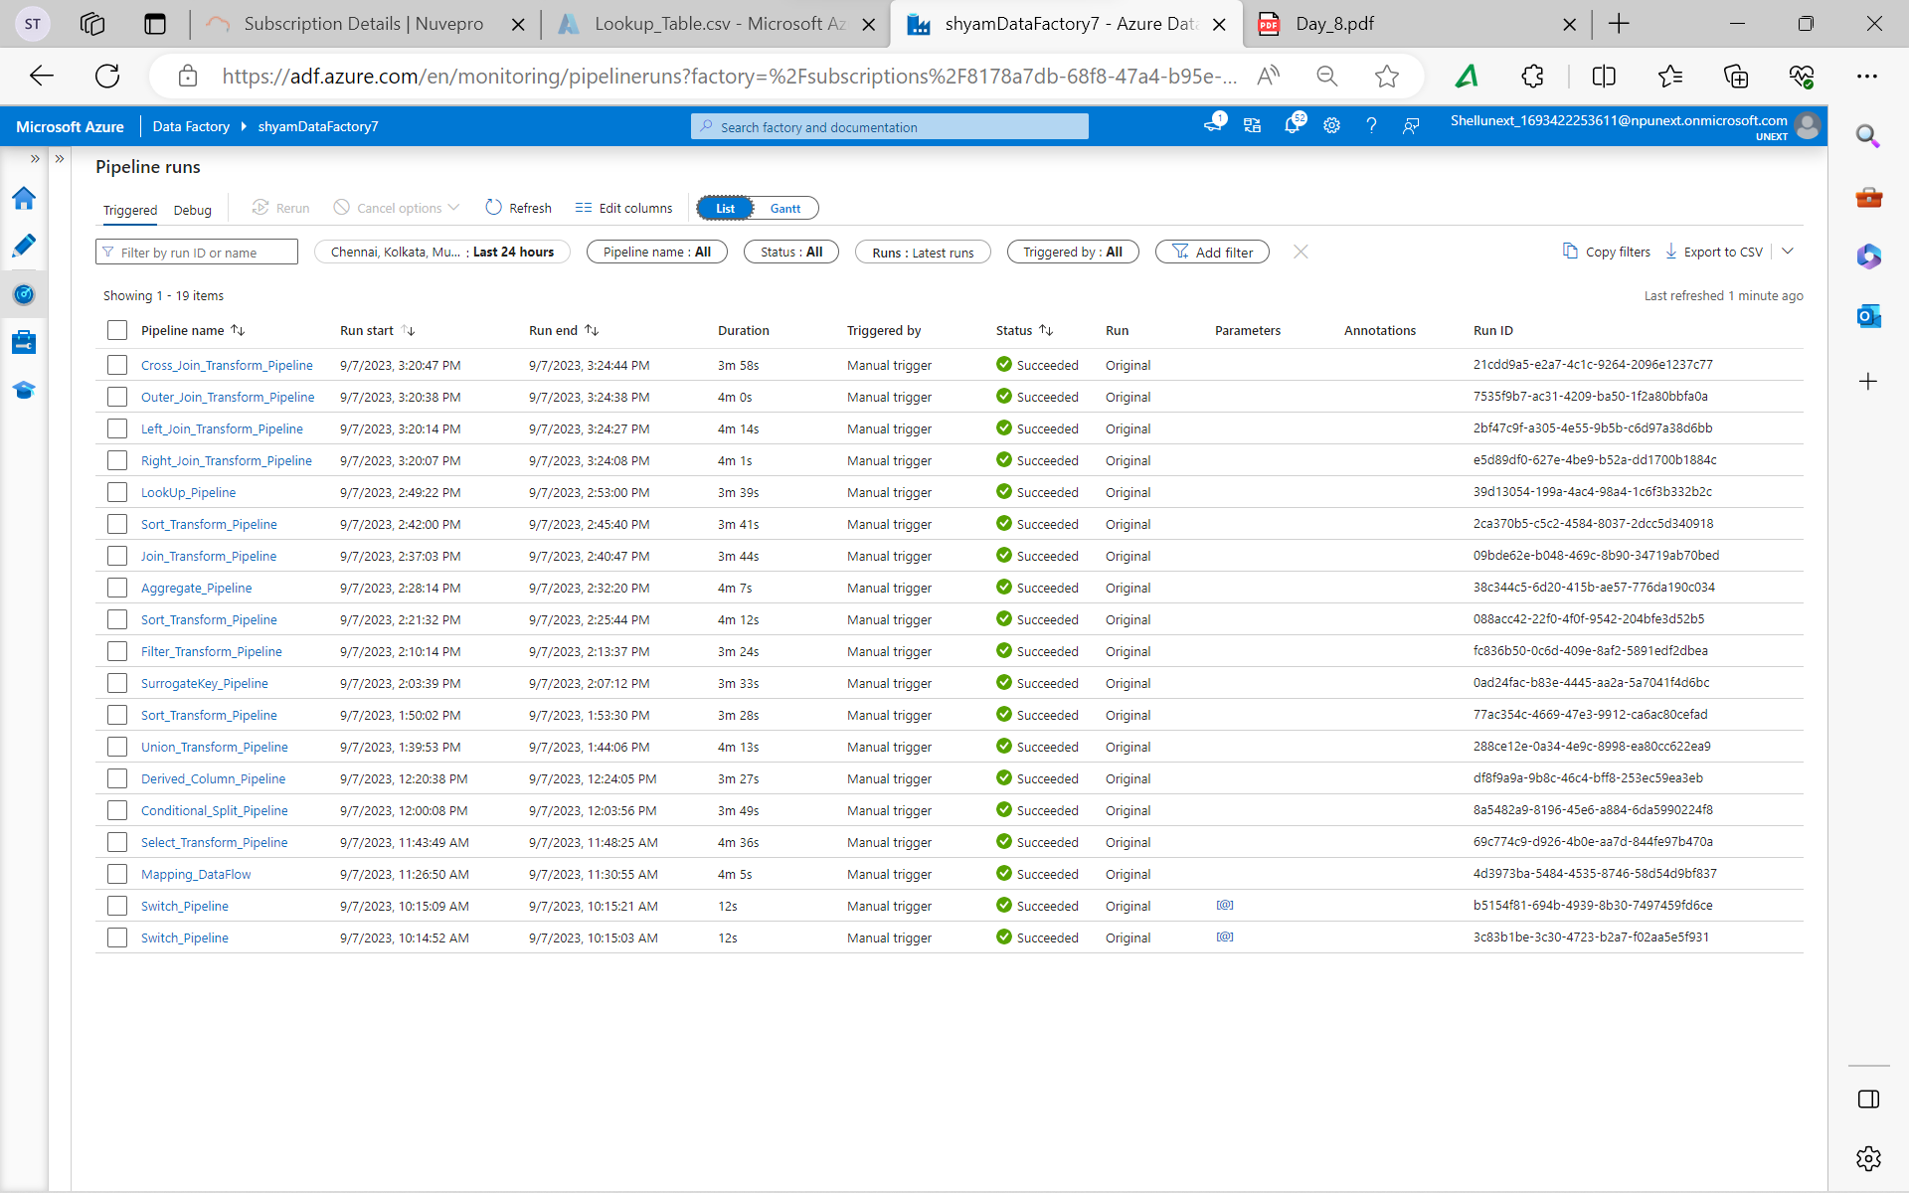
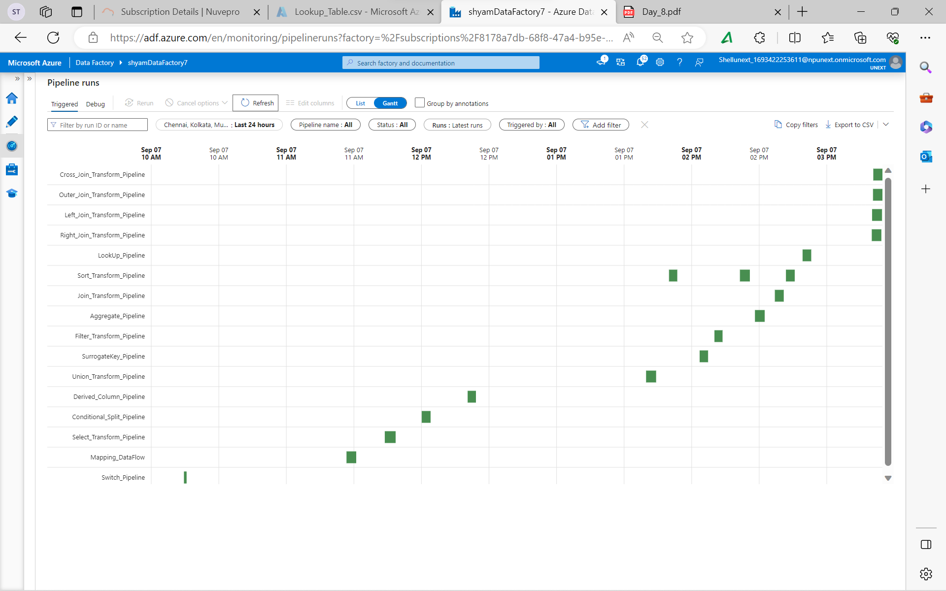
AZURE DATA FACTORY DAY-3
7th Sept
Hands On Lab:
Data Flow Activities
Mapping Data Flow
Select Transformation
Conditional Split Transformation
Derived Column Transformation
Union Transformation
Surrogate Key Transformation
Filter Transformation
Aggregator Transformation
Join Transformation
Inner
Outer
Cross
Left
Right
Lookup Transformation
Pipeline Using REST

Slide 15
AZURE DATA FACTORY DAY-4
8th Sept
Topics Covered:
Control Flow Activities
Lookup
Script
Stored Procedure
Data Flow Activities
Parameterize
Stringify Transformation
Pivot Transformation
Unpivot Transformation
Window Transformation
Alter Row Transformation
Cast Transformation
Web Page Usage
Rest Pagination
Rank Transformation
Parse Transformation
Assert Transformation
Hands On Lab:
Change Data Capture
CDC Real Time
Topics Covered:
Dynamically Pass Expression
Condition Logic
User Defined Functions
Error Handling
Create Alert
Create Azure Automation
Create Schedule
Flowlet
Slowly Changing Dimension 1
Slowly Changing Dimension 2

Slide 16
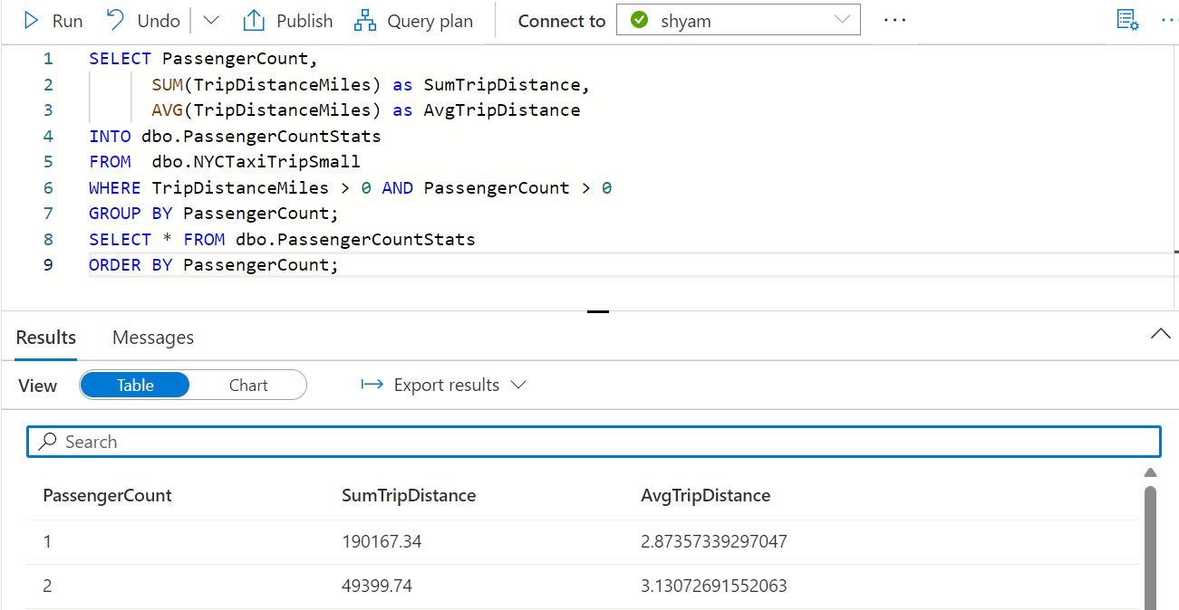
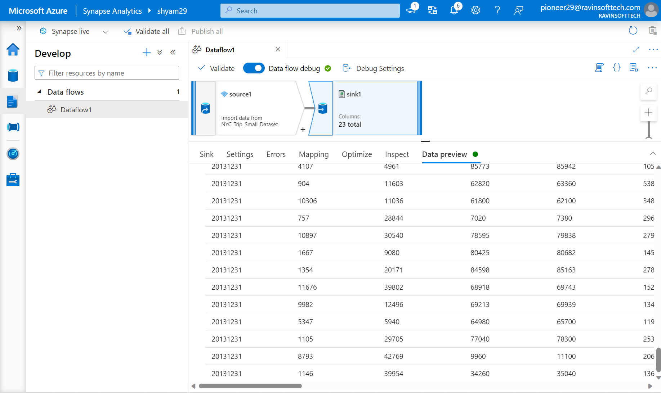
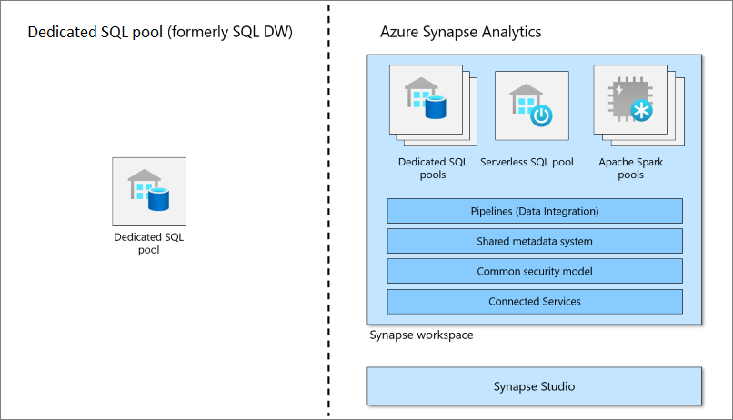
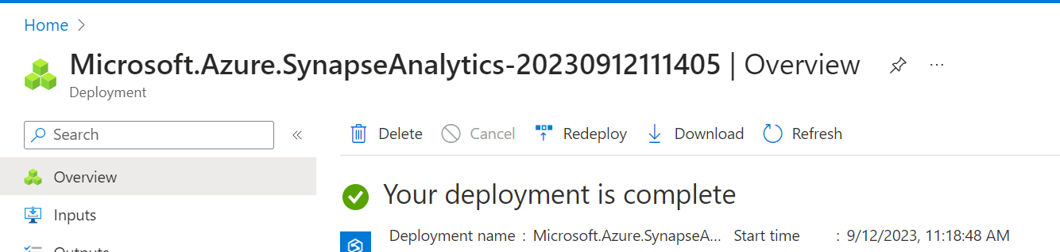
AZURE SYNAPSE ANALYTICS
12th Sept
Hands On Lab:
Creating Azure Synapse Analytics Workspace
Creating Dedicated SQL Pool
Analyze data with a dedicated SQL Pool
Mapping Data Flow in ASA
Querying and Analyzing Data
Writing and Executing Queries

Slide 17
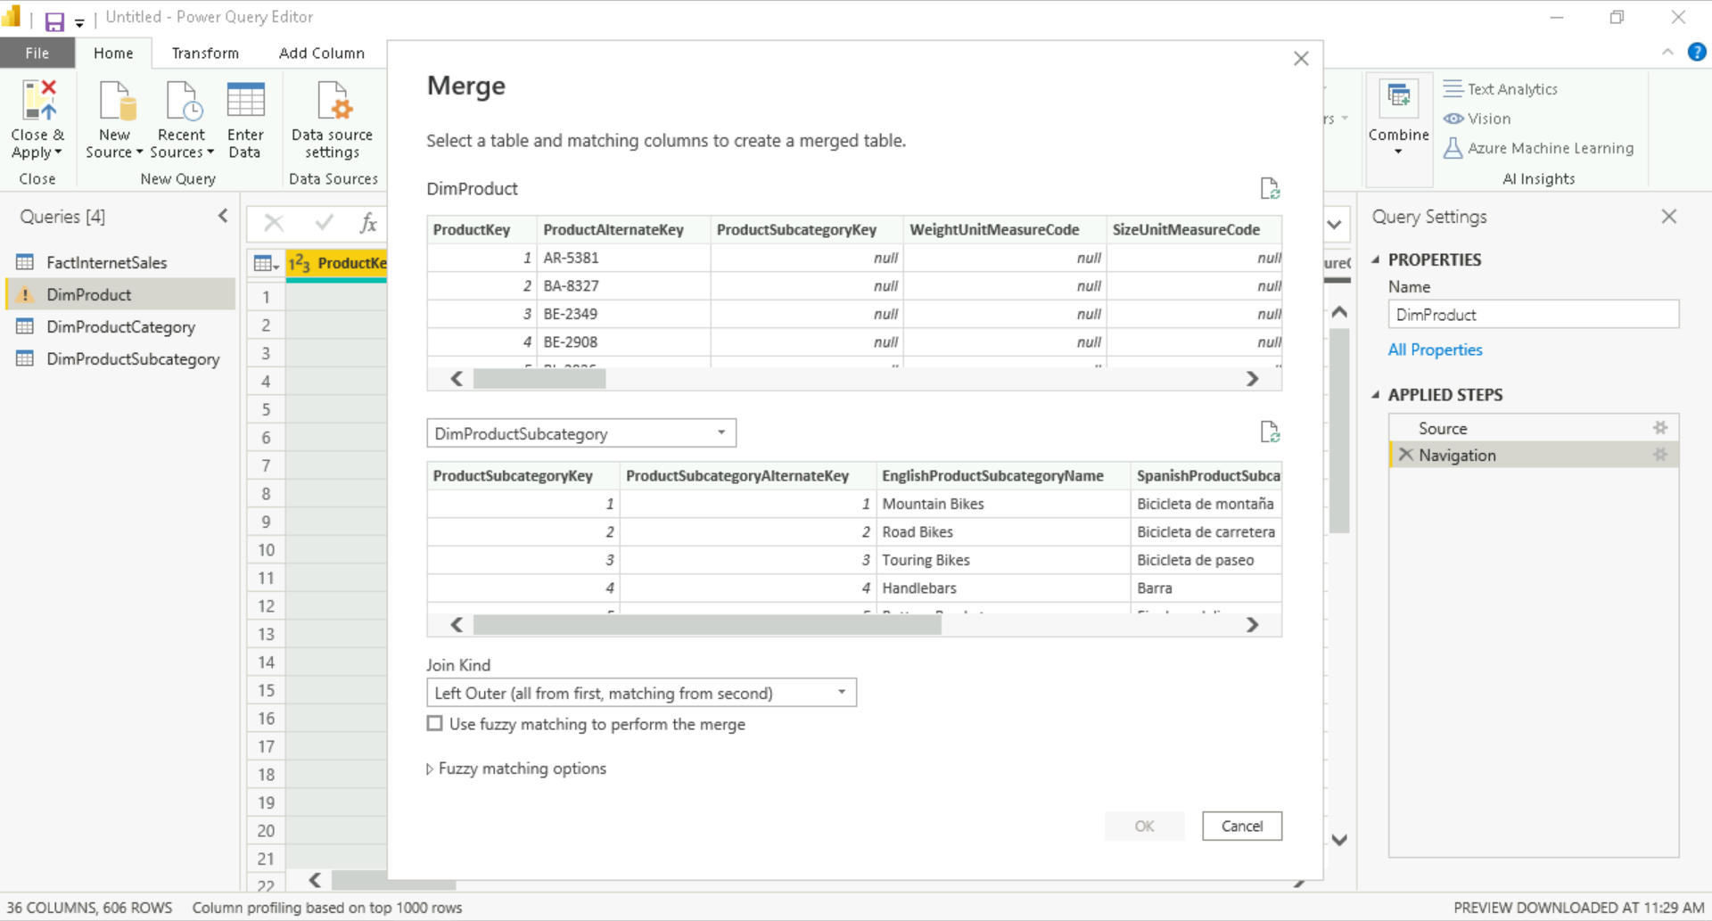
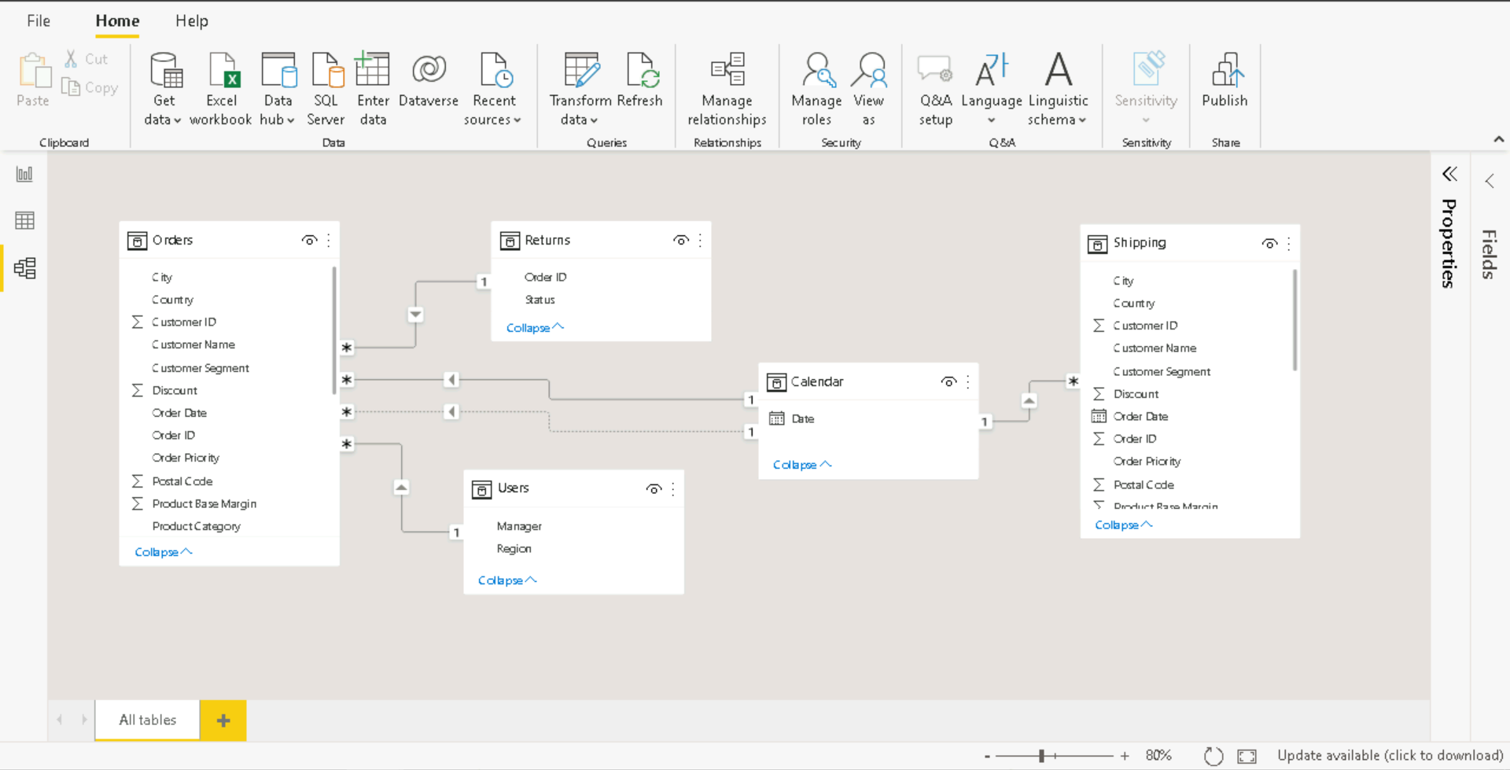
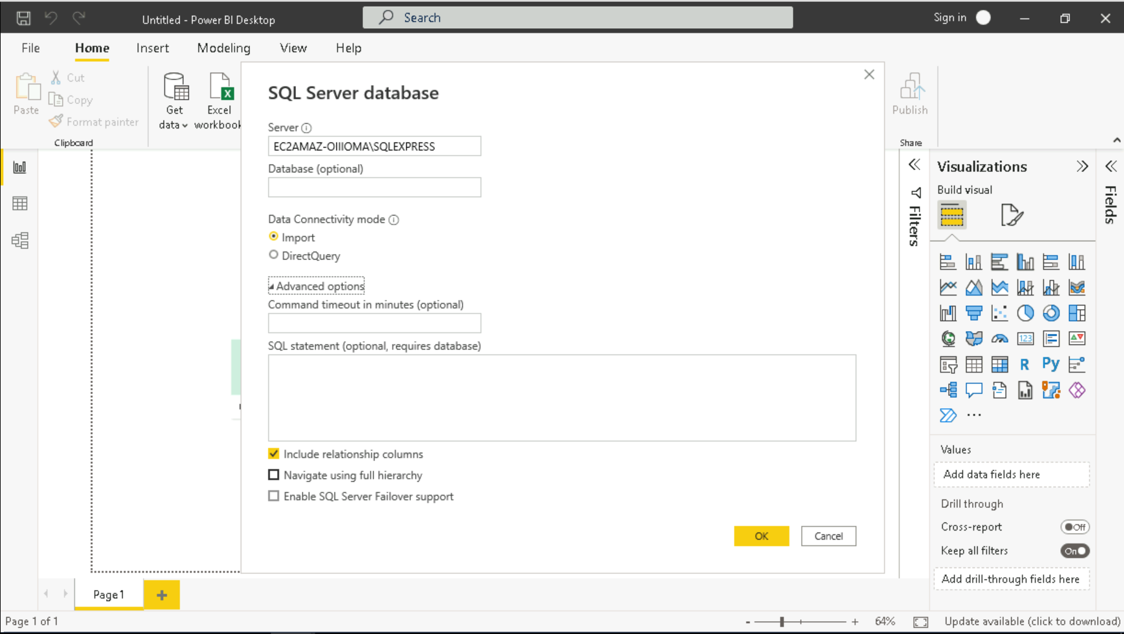
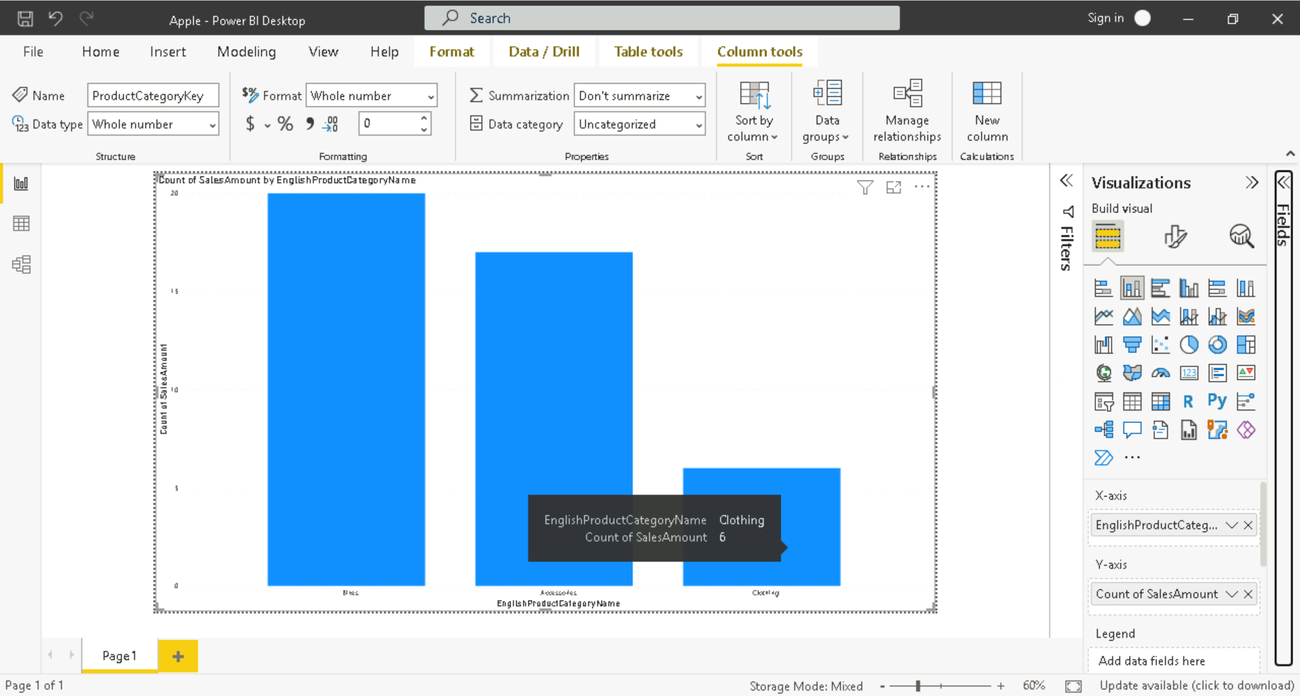
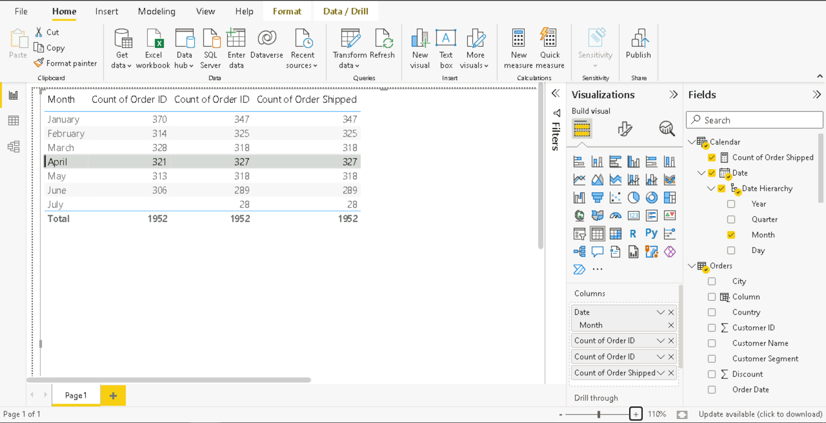
POWER BI DAY-1
13th Sept
Hands On Lab:
Connecting to various sources
Data Loading
Data Transformation
Power Query Editor
Creating Relationships
Managing Active Inactive Relationships
Creating Visualizations
Creating Tables

Slide 18
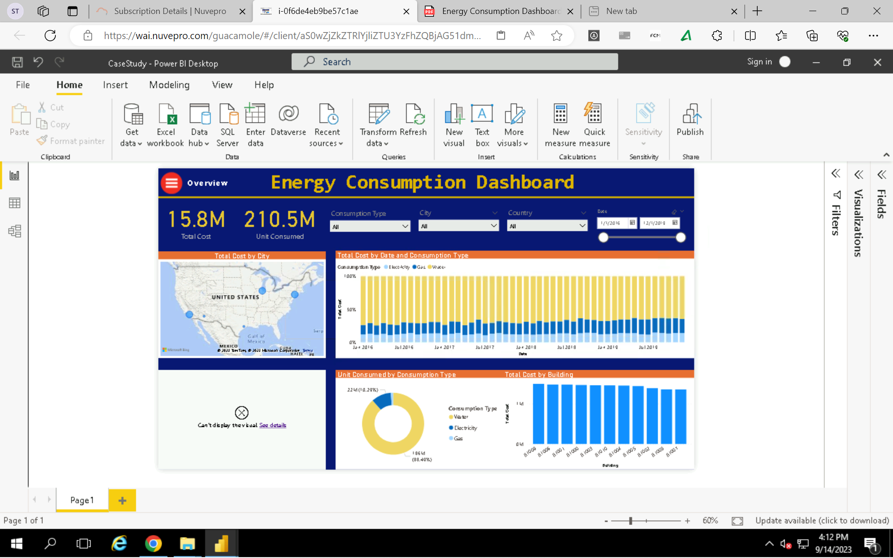
POWER BI DAY-2
14th Sept
Hands On Lab:
Header Promotion
Adding Calculated Column
Merging Tables
Combining Columns
Filtering Columns
Intro to DAX
Handling Dates
Creating Hierarchy
Slicers
Intro to different Visualizations
Maps, Filled Maps, Legends
Buttons
Bookmarks
Row Level Security
Aggregation Functions
Creating a Dashboard

Slide 19

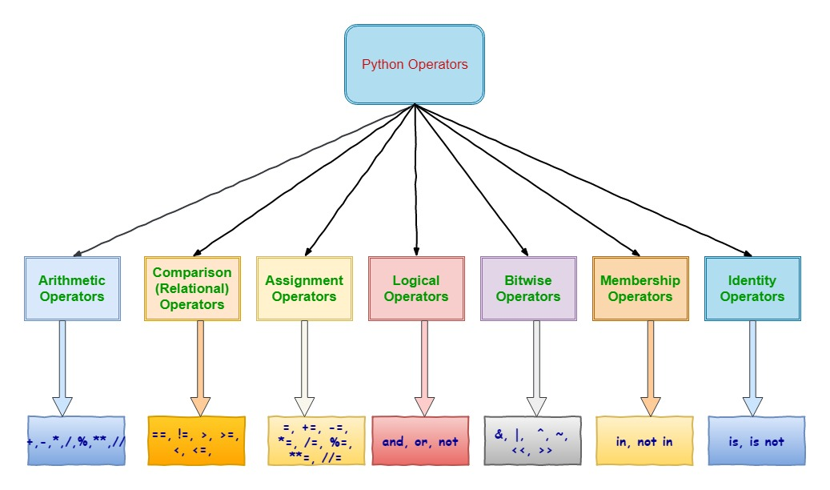
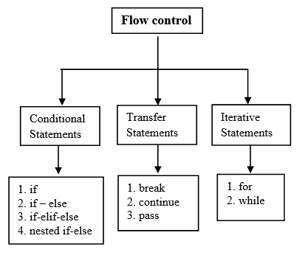
PYTHON DAY-1
15th Sept
Hands On Lab:
Print Hello World
Data Types
Mutable and Immutable
Arithmetic Operators
Relational Operators
Logical Operators
Membership Operators
Hands On Lab:
Flow Control
Input
Range
Zip
Enumerate
Counter
User-Defined Functions

Slide 20

PYTHON DAY-2
19th Sept
Hands On Lab:
User Defined Functions
Types of Arguments:
Positional
Keyword
Default
Variable Length
Recursive Function
Decorator Function
Generator Function
List Comprehension
Lambda Function
Map Function
Sorted Function
Classes

Slide 21
PYTHON DAY-3
20th Sept
Hands On Lab:
Pandas
Creating a DataFrame
Head, Tail
Describe, Info, Shape
Renaming columns
Assigning a new column
Dtypes, Converting Types
Handling Date Type
Reading CSV Files
Slicing and Indexing
Querying
Dropping Columns
Checking and Replacing null columns
Value Counts
Unique Values
Group By
Saving DataFrame
Hands On Lab:
Numpy
Array
Ndim
Concatenate
Slicing and Indexing
Max
Min
Standard Deviation
Mean
Matplotlib
Line Chart
Xlabel, Ylabel, Title
Marker, Linestyle, Figsize
Bar Chart
Color, Width

Slide 22
PYspark DAY-1
21st Sept
Theory:
Big Data
Characteristics of Big Data
Forms of Big Data
Hadoop 1.0
Resources
Big Data Tools
Apache Spark
Hadoop vs Spark
Features of Spark
PySpark
Spark’s Basic Architecture
Cluster Manager
Spark Toolset
Deployment Mode
RDD, DataFrame, Dataset
ETL, ELT Process
Spark Context
Hands-On-Lab
Creating Spark Context
Creating RDD
Using Lambda Function with Map and Filter
Creating Spark Session
Creating DataFrame
Show
Print_Schema
Dtypes, Converting Types
Reading CSV
Options in CSV – header, inferschema
Renaming Columns
Select
Concat
Dropping Columns
Saving CSV

Slide 23
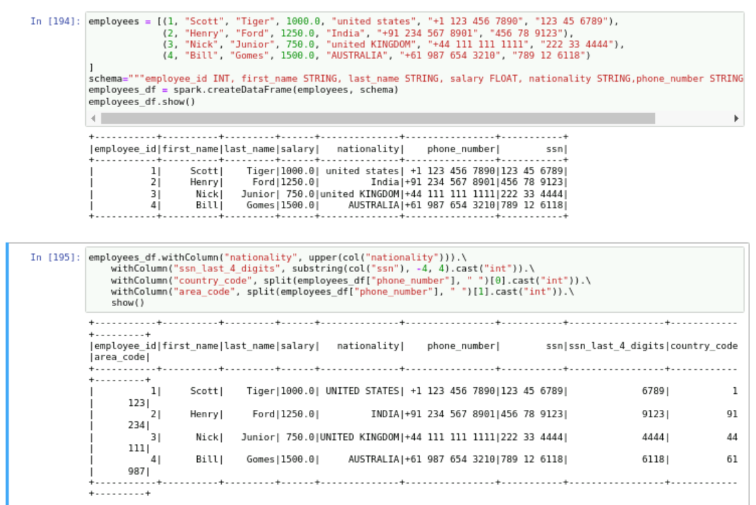
PYspark DAY-2
22nd Sept
Hands On Lab:
Defining Schema using PySpark Data Types
Explode Function
Reading From JSON file
Current Timestamp Ingestion Date
Saving File in Parquet
Saving as Table
Using SQL Query
Grouping Data
Sorting Data
Making Bar Charts
Join
Filter
Opening SparkUI
Cache and Memory
Persist

Slide 24
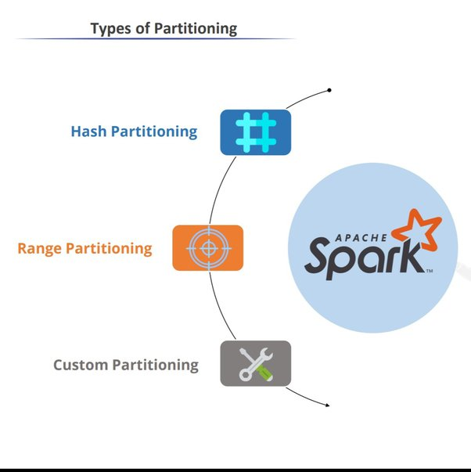
PYspark DAY-3
25th Sept
Hands On Lab:
isNull/isNotNull in SELECT queries
order_by asc/desc
asc_nulls_first/asc_nulls_last
desc_nulls_first/desc_nulls_last
drop_duplicates
dropna/na.drop
fillna/na.fill
sort
partition_by

Slide 25
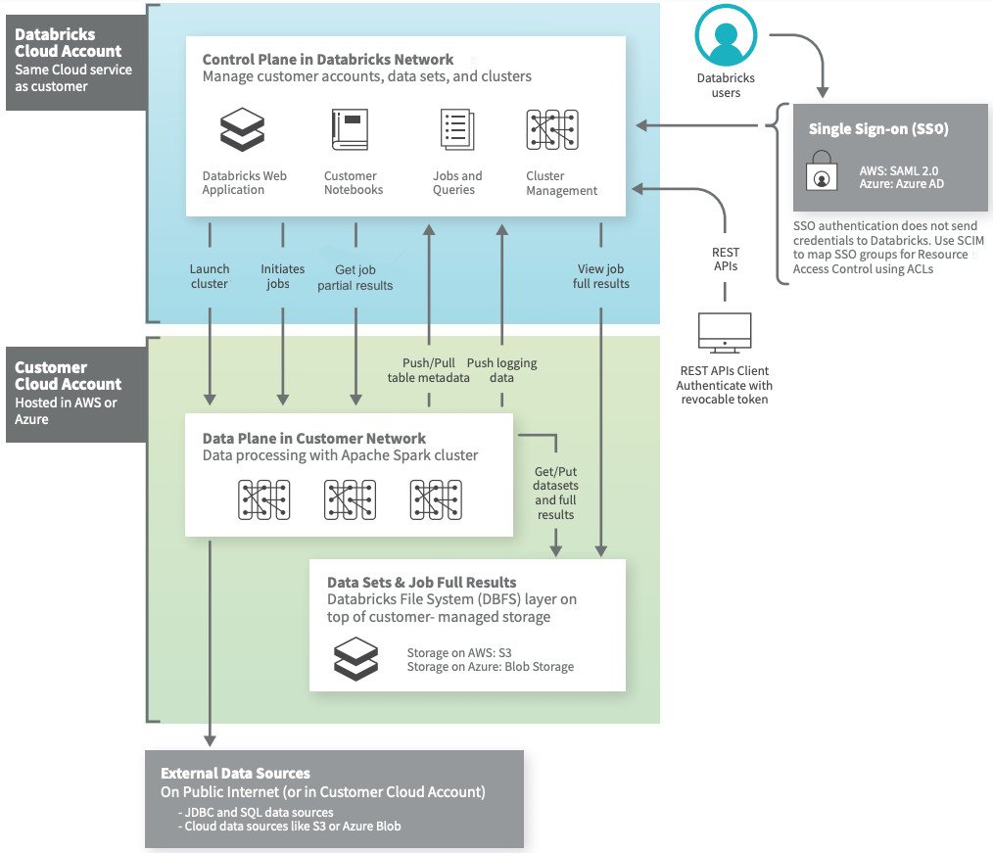
DATABRICKS DAY-1
26th Sept
Theory:
Databricks
Cluster
Catalog
Databricks Architecture
Hands On Lab:
Creating Databricks Workspace
Creating Compute Cluster
Creating Notebook in Workspace and Adding Compute
Magic Commands
Functions done in Pyspark
Describe extended, detail, history
Creating Catalog
Dataframe using Catalog
Mounting
Read Streaming Data

Slide 26
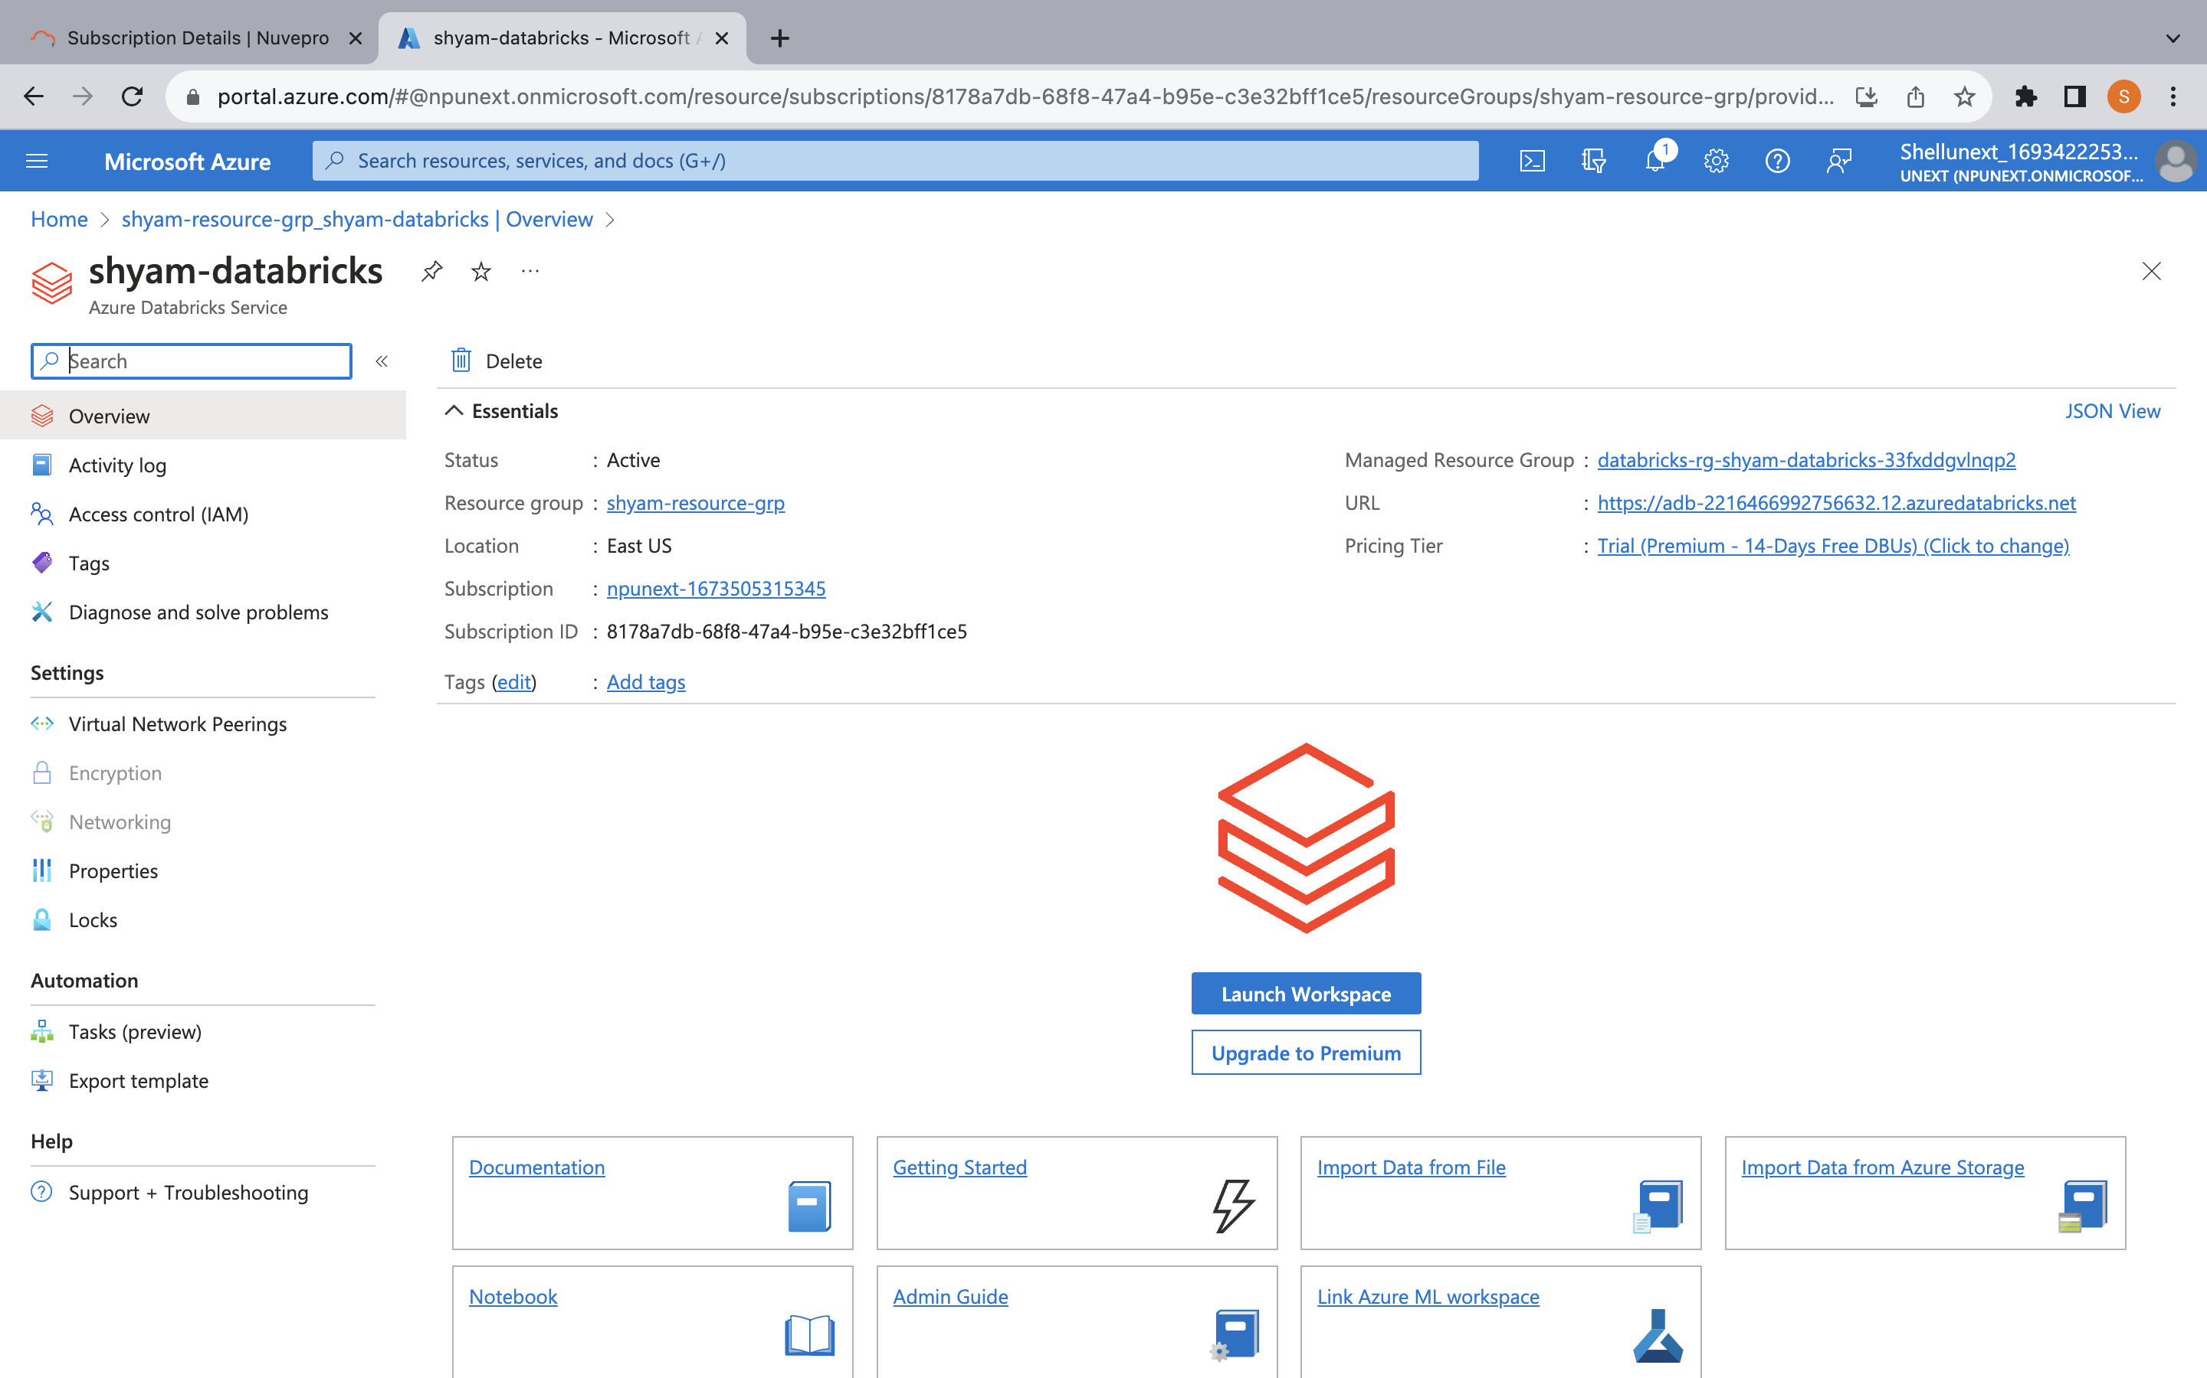
DATABRICKS DAY-2
27th Sept
Theory:
Introduction to Medallion Architecture
Limitations of Data Lake
Limitations of Data Warehouse
Introduction to Data Lakehouse
Architecture of Delta Lakehouse
Key Features
Time Travel
File Formats in Delta Lake
Hands On Lab:
Mounting data into data lake, reading JSON file, writing data in parquet and delta
Delta CRC
Storage File Format when doing CRUD Operations
Integration with Data Factory
Scheduling Notebooks in Data Factory
Creating SQL Data Warehouse
Intro to Unity Catalog
Running SQL Queries
Making Visualizations
Adding Visualizations to Dashboards
Connection From SQL Schema
Making Widgets

Slide 27
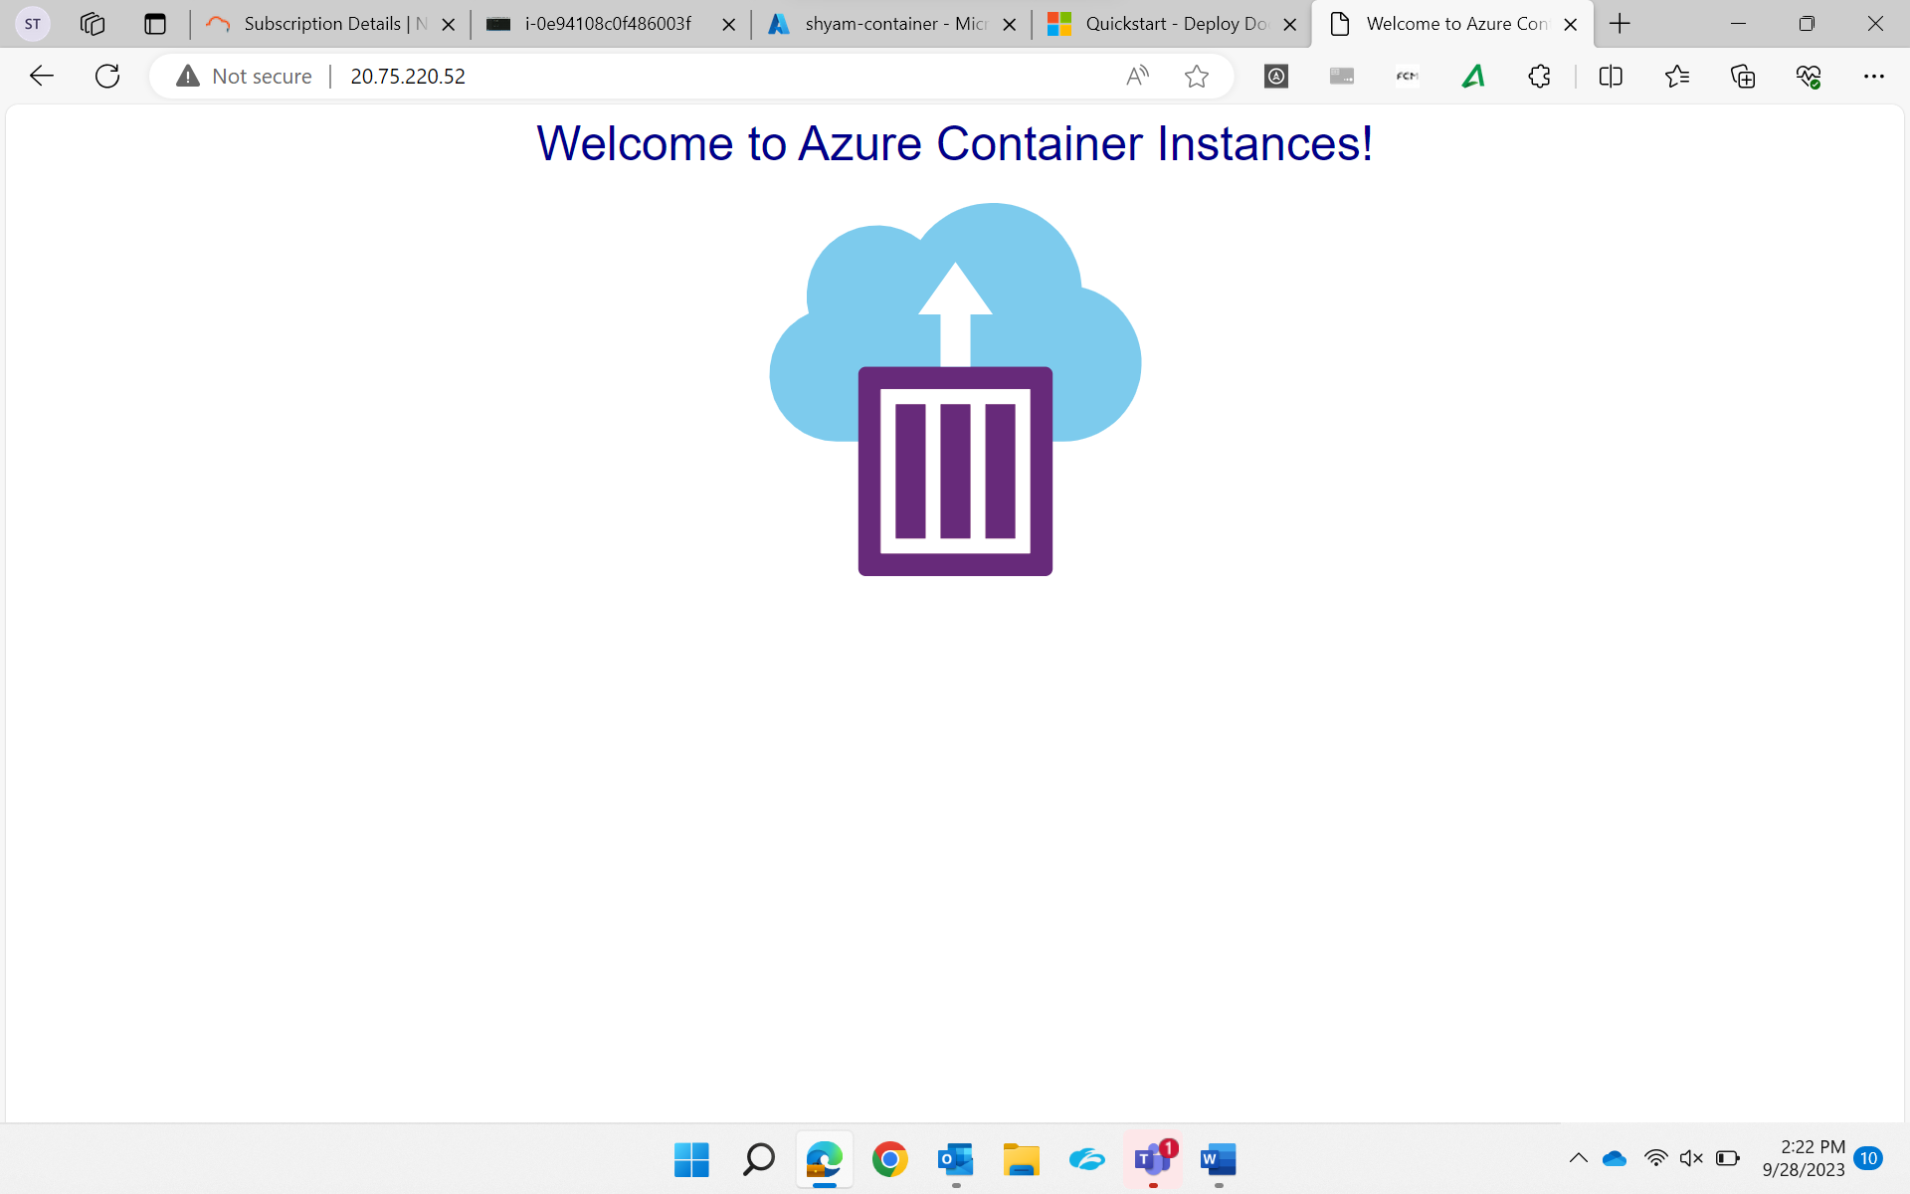
Azure COntainers
28th Sept
Theory:
Intro to Docker Containers
Features of Docker Container
Architecture od Docker
Docker Daemon
Docker Client
Docker Host
Docker Objects
Docker Registry
Docker Images
Docker Containers
Docker Storage
Azure Container Services
Azure Container Registry
Intro to Kubernetes
Features of Kubernetes
Architecture of Kubernetes
Hands On Lab:
Creating Docker Containers
Deploy Azure Container Instances
View Container Logs
Creating Container Registry

Slide 28
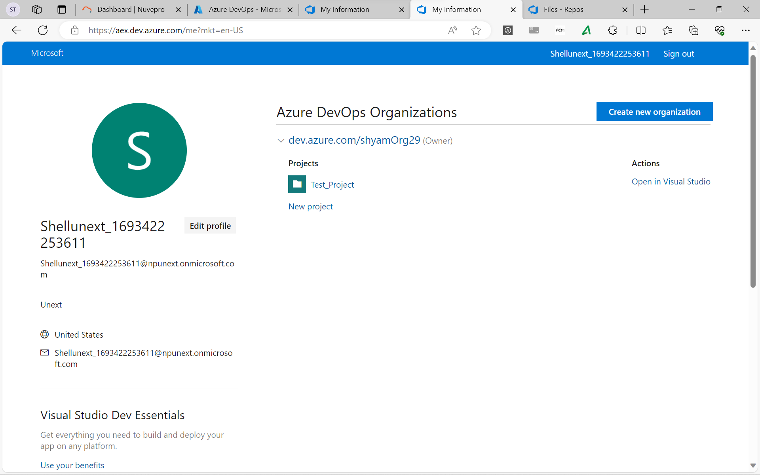
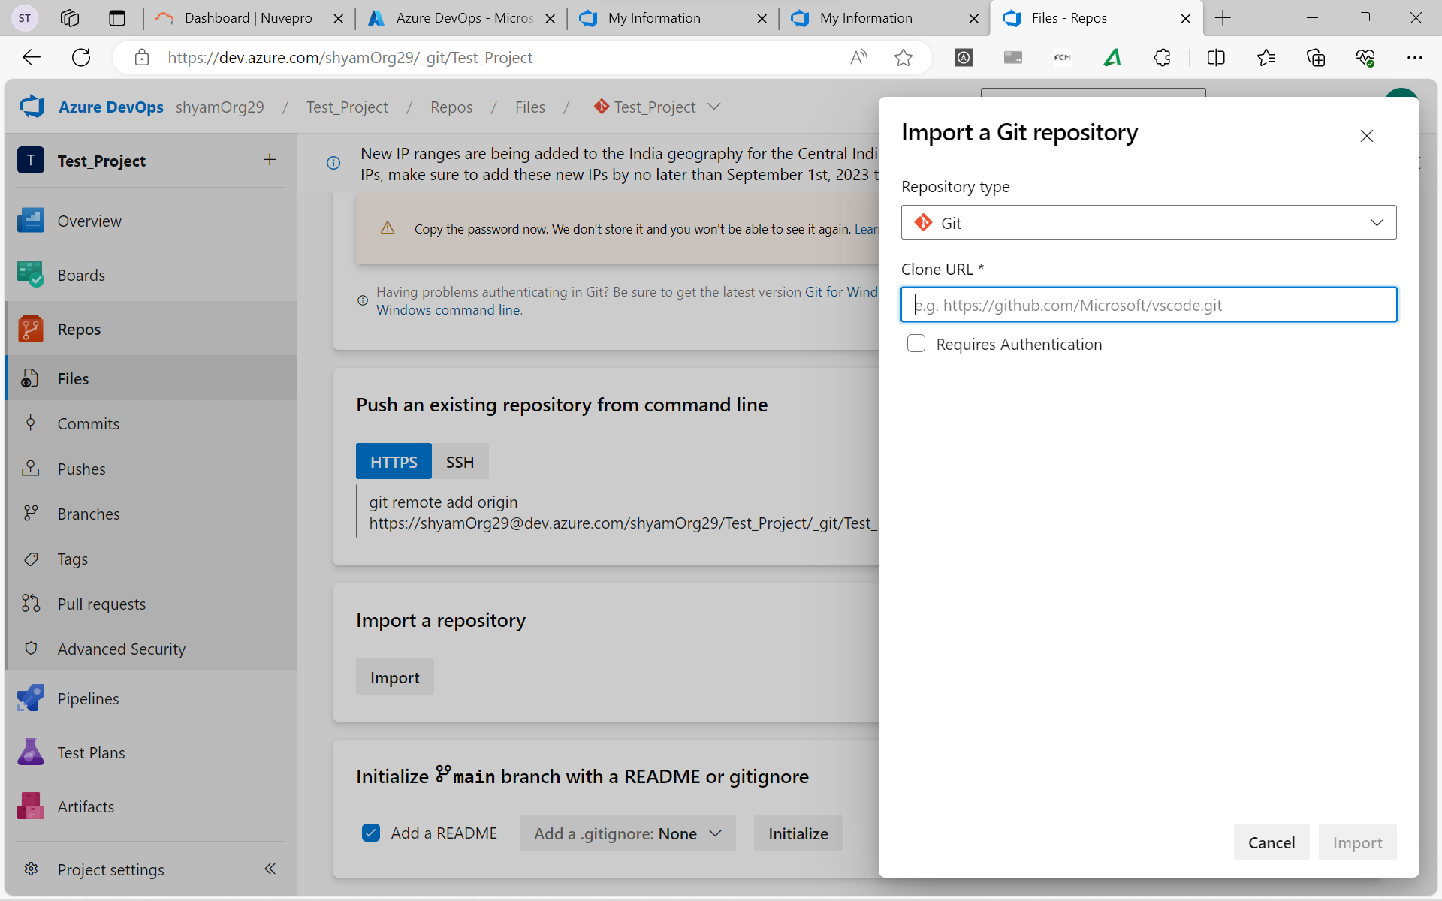
AZURE DEVOPS
29th Sept
Theory:
DevOps
OODA
Explore the DevOps Journey
Explore Agile Development Practices
Waterfall
Agile
Choose the DevOps tools
What is Azure DevOps?
What is GitHub?
Explore an authorization and access strategy
GitHub Project Boards
GitHub Projects
Monorepos vs Multiple Repos
Feature Branch Workflow
Traditional IT Development Cycle
Principle of Continuous Delivery
Release Pipelines
Artifact Sources

Slide 29
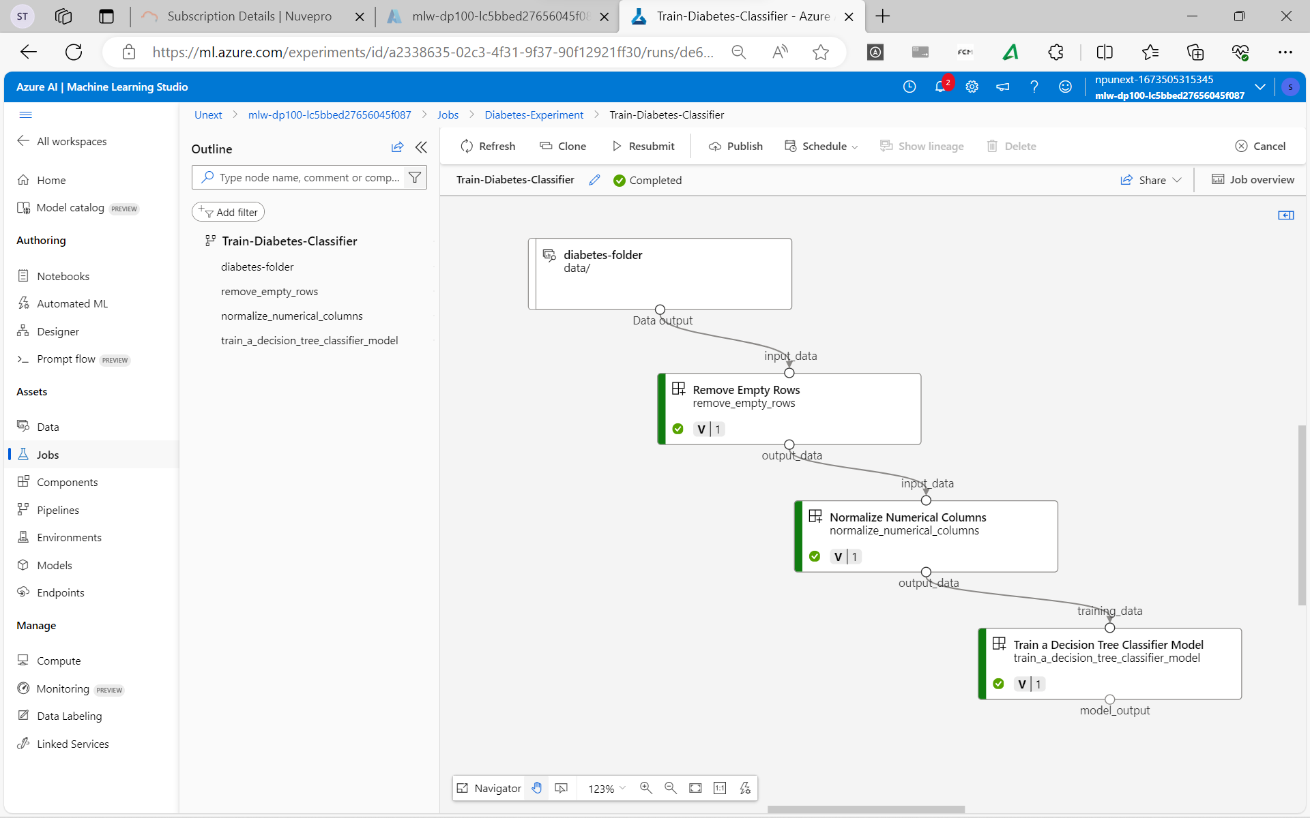
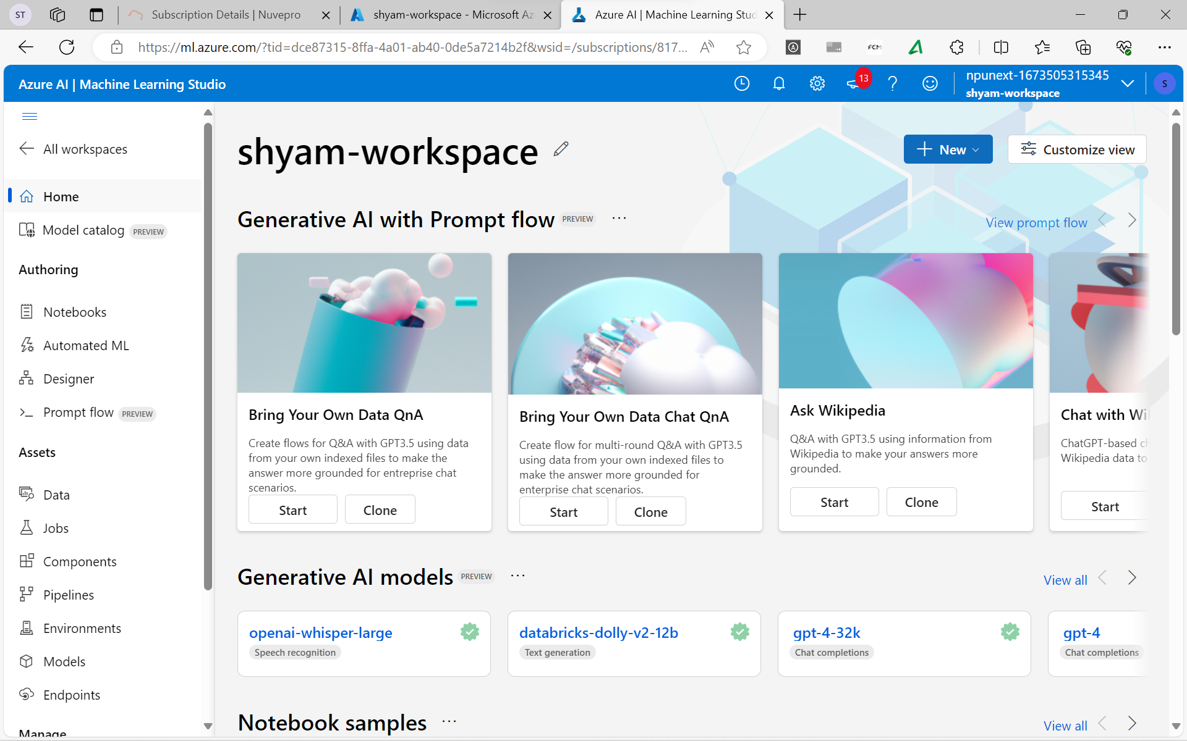
AZURE ML STUDIO DAY-1
3rd Oct
Theory:
Introduction to Azure ML
Giving Access to Azure ML Workspace
Identify ML Resources
Identify Azure ML Assets
Types of Job
Explore ML Studio
Explore CLI
Understanding URIs
Creating Component
Creating Pipeline
Hands On Lab:
Creating ML Workspace
Creating Compute Cluster
Creating Data Asset
Git Cloning with Azure CLI
Creating and Setting up a Pipeline Job

Slide 30
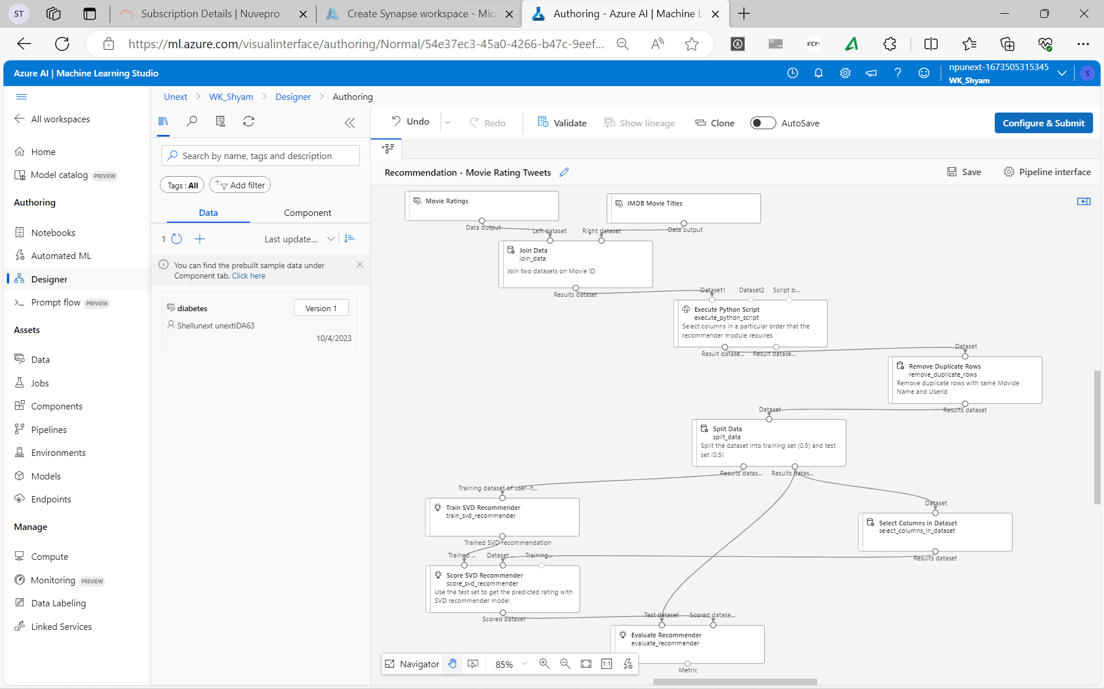
AZURE ML STUDIO DAY-2
4th Oct
Theory:
Converting Notebook to Script
Configuring a Command Job
Use Parameters in a Command Job
Understand Hyperparameter Tuning
Defining a Search Space
Configuring Sampling Method
Configuring Early Termination
Bandit and Median Stopping Policy
Using a Sweep Job for Hyperparameter Tuning
Hands-On Assessment

